Slide 1
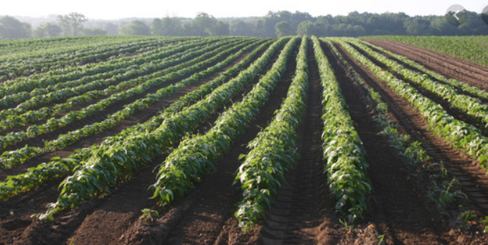
.
GREENE COUNTY AGRICULTURAL FARMLAND PROTECTION BOARD MEETING November 9, 2022 Cornell Cooperative Extension 6055 NY-23, Acra, NY 7:00 PM
CCE-CG Photo

Slide 2
Agenda
- Introduction of new board members
Review and discussion of 2022 Request for Inclusions
Scheduling of Public Hearing
Stoneledge Farm

Slide 3
Current Status
Agricultural District No. 124
823 Parcels
41,370.69 acres
within the County of Greene, in the Towns of Ashland, Athens, Cairo, Catskill, Coxsackie, Durham, Halcott, Hunter, Greenville, Jewett, New Baltimore, Prattsville, Lexington, Windham and the Villages of Athens, Catskill, Coxsackie, Hunter, and Tannersville (entirety of Greene County)

Slide 4
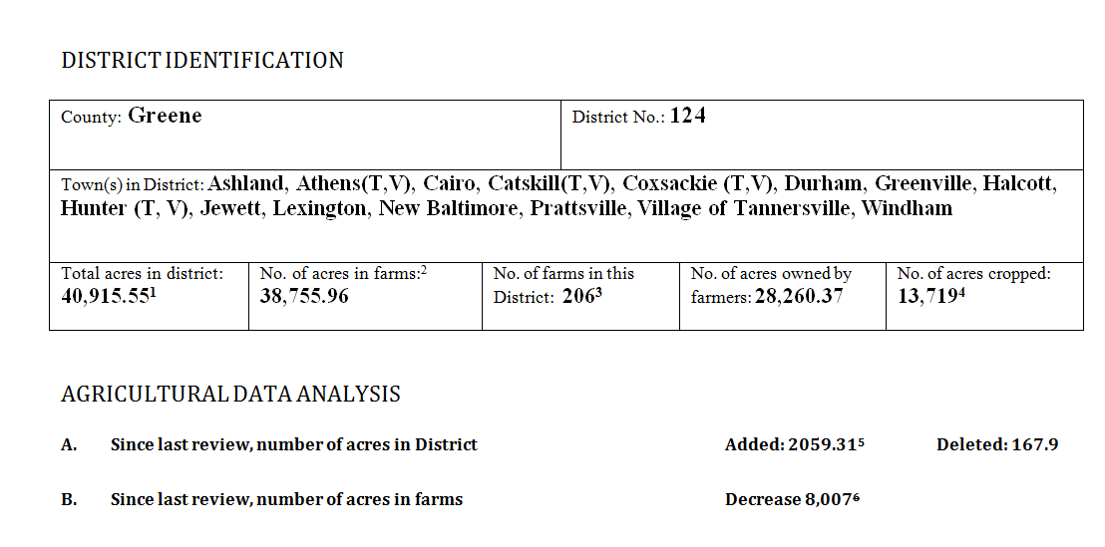
Approved Ag District No. 124 Following 2019-20 Eight-Year Review
816 Parcels
1. A. Owned and Farmed: 28,260.37 acres (69.07% of 40,915.55)
B. Rented to Farmer: 10,085.68 acres (24.65 of 40,915.55)
C. Rented From Another Landowner: 634.19 acres (1.55% of 40,915.55)
D. Not Farmed 19,353.06 acres in the Ag District No. 124 (4.73% of 40,915.55)
2.Number of acres in farms represents the sum of acres owned by farmers and rented by farmers.
3. 2017 Census of Agriculture
4. Ibid
5. Difference between 2012: 38,856.24 acres, 2020: 40,915.55 acres
6. Decrease based on acres reported on 2012 (42,986 acres) and 2017 (34,979) Census of Agriculture

Slide 5
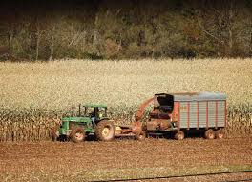
Review Processes for Agricultural District
Annual Review
Eight Year Review
(including Requests for Inclusion)
AFPBs evaluate two factors when making recommendations:
1) Whether the parcel of land consist predominantly of “viable agricultural land” and
2) Whether the inclusion of the land serve the public interest by assisting in maintaining a viable agricultural industry within the district.
Watershed Agricultural Council

Slide 6
Owner | Address | Town/Village | Tax Map ID | Acres
Linda Suwara | 114 Rockwell Rd. | Cornwallville | 48.00-2-12 | 1.1
Linda Suwara | Rockwell Rd. | Cornwallville | 48.00-2-50.11 | 26.20
Linda Suwara | 114 Rockwell Rd. | Cornwallville | 33.00-4-16.112 | 25.60
BM181825 Holdings LLC | 3 Leon Macglashan Rd | Windham | 97.00-1-79.1 | 210.4
Nina Pfeffer | 2620 Rt. 42 | Westkill | 160.00-2-2.2 | 2.3
Pound Lane LLC | 1294 Rudolph Weir Jr Rd. | Earlton | 85.00-2-3 | 85.55
Alfred Suwara | 707 Stonebridge Rd | Cornwallville | 33.00-4-16.111 | 50
Alfred Suwara | 156 E. Hawley Ln. | Hanacroix | 29.00-3-17 | 319.5
Anthony Roman | Route 20 | Durham | 49.00-5-1.22 | 22.3
Anthony Roman | 258 Dunn Rd | Durham | 49.00-5-1.21 | 12.08
Anthony Roman | 204 Dunn Rd | Durham | 49.00-5-1.1 | 19.9
Anthony Roman | 168 Paddock Rd | Durham | 49.00-5-17 | 12.51
Anthony Roman | Paddock Rd | Durham | 49.00-5-6 | 38.00
Manoj Subudhi | E Hawley Ln. | Hannacroix | 29.00-3-18 | 40.00
Otto Suwara | 711 Stone Bridge Rd | Cornwallville | 33.00-4-22 | 28.90
Otto Suwara | 711 Strone Bridge Rd | Cornwallville | 33.00-4-21 | 6.20
Angela Worth | 513 Rt. 67 | Leeds | 101.00-2-67 | 120
GCSWCD | 421 CR56 | Windham | 97.00-3-37 | 12.28
2022 Request for Inclusion Ag District
No. 124
18 Total Parcels
1,032.82 total proposed acres
Notes:
AML Sections 303 (district creation), 303-a (district review), 303-b (annual inclusion of lands) and 303-c (district consolidation

Slide 7
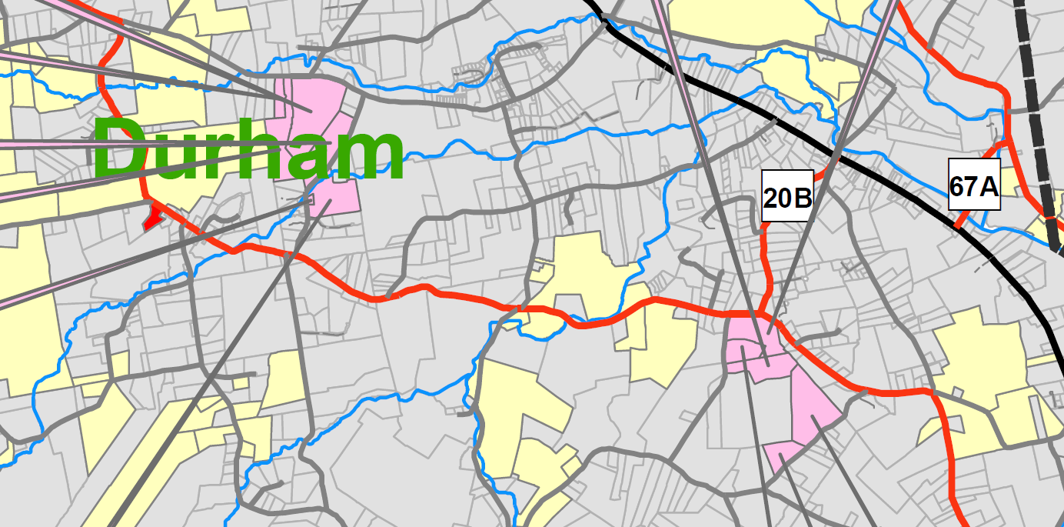
Linda Suwara | 114 Rockwell Rd. | Cornwallville | 48.00-2-12 | 1.1
Linda Suwara | Rockwell Rd. | Cornwallville | 48.00-2-50.11 | 26.20
Linda Suwara | 114 Rockwell Rd. | Cornwallville | 33.00-4-16.112 | 25.60

Slide 8
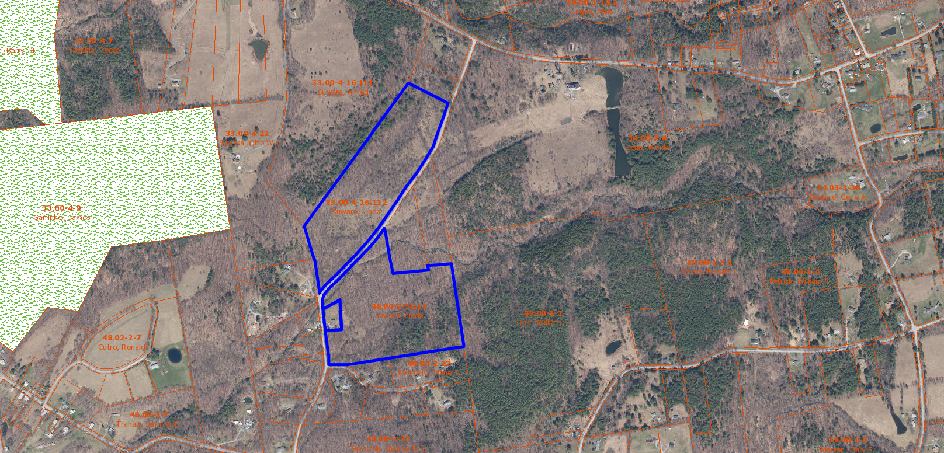
Linda Suwara | 114 Rockwell Rd. | Cornwallville | 48.00-2-12 | 1.1
Linda Suwara | Rockwell Rd. | Cornwallville | 48.00-2-50.11 | 26.20
Linda Suwara | 114 Rockwell Rd. | Cornwallville | 33.00-4-16.112 | 25.60

Slide 9
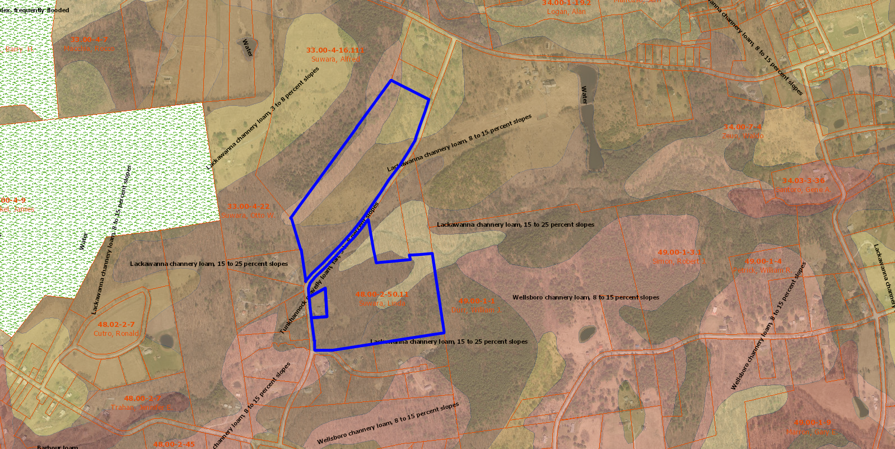
Linda Suwara | 114 Rockwell Rd. | Cornwallville | 48.00-2-12 | 1.1
Linda Suwara | Rockwell Rd. | Cornwallville | 48.00-2-50.11 | 26.20
Linda Suwara | 114 Rockwell Rd. | Cornwallville | 33.00-4-16.112 | 25.60

Slide 10
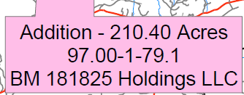
BM181825 Holdings LLC | 3 Leon Macglashan Rd | Windham | 97.00-1-79.1 | 210.4

Slide 11
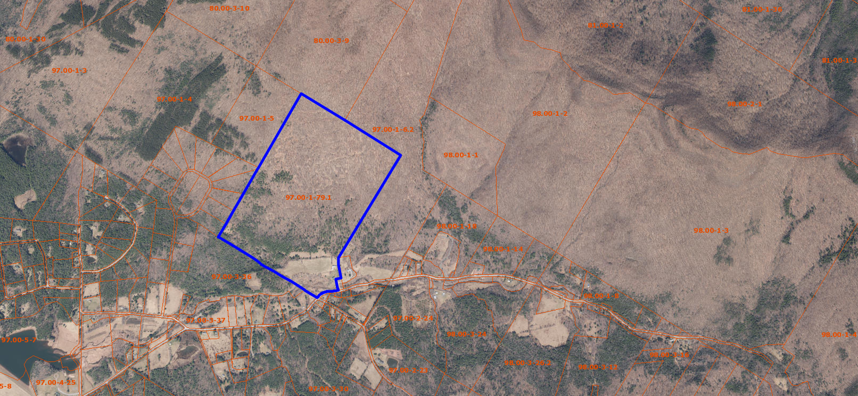
BM181825 Holdings LLC | 3 Leon Macglashan Rd | Windham | 97.00-1-79.1 | 210.4

Slide 12
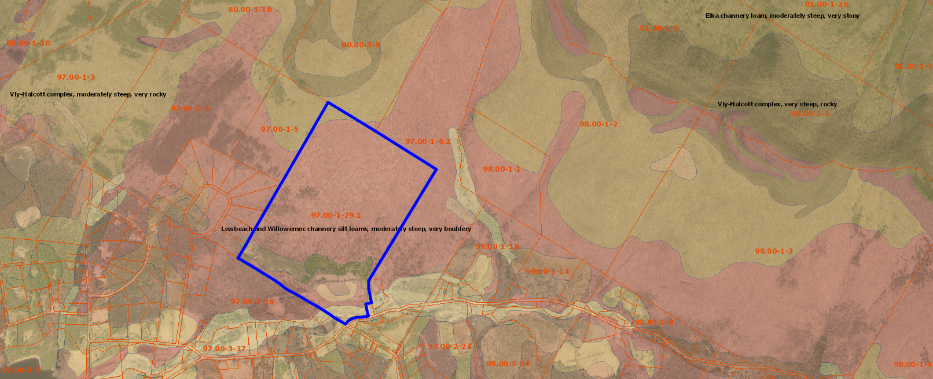
BM181825 Holdings LLC | 3 Leon Macglashan Rd | Windham | 97.00-1-79.1 | 210.4

Slide 13
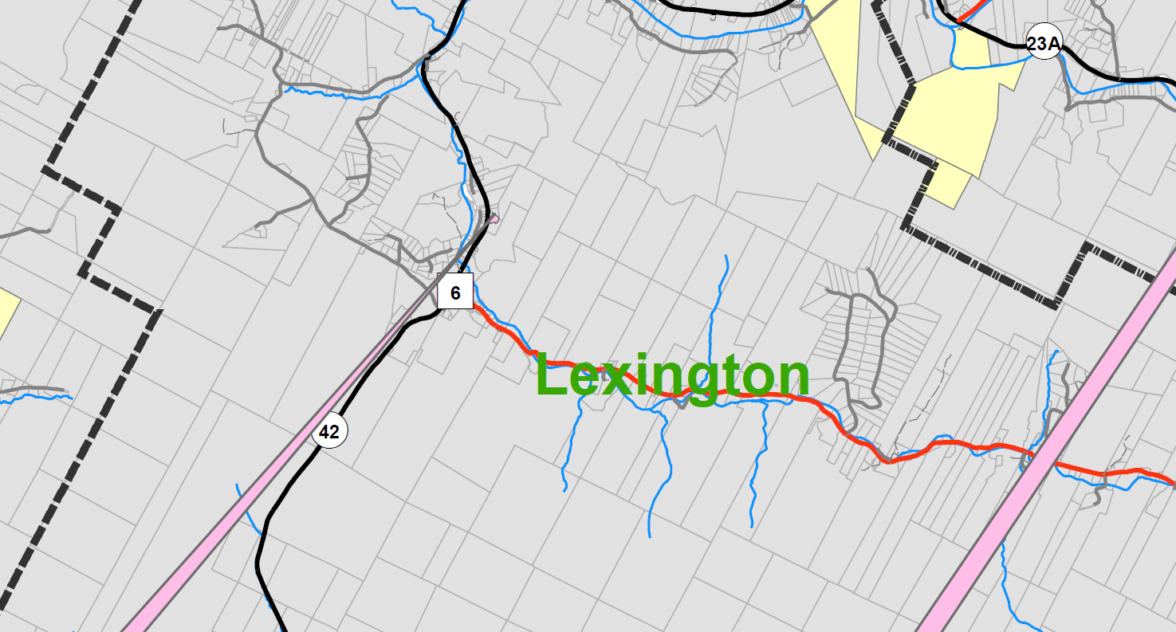
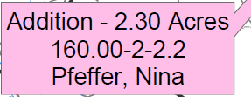
Nina Pfeffer | 2620 Rt. 42 | Westkill | 160.00-2-2.2 | 2.3

Slide 14
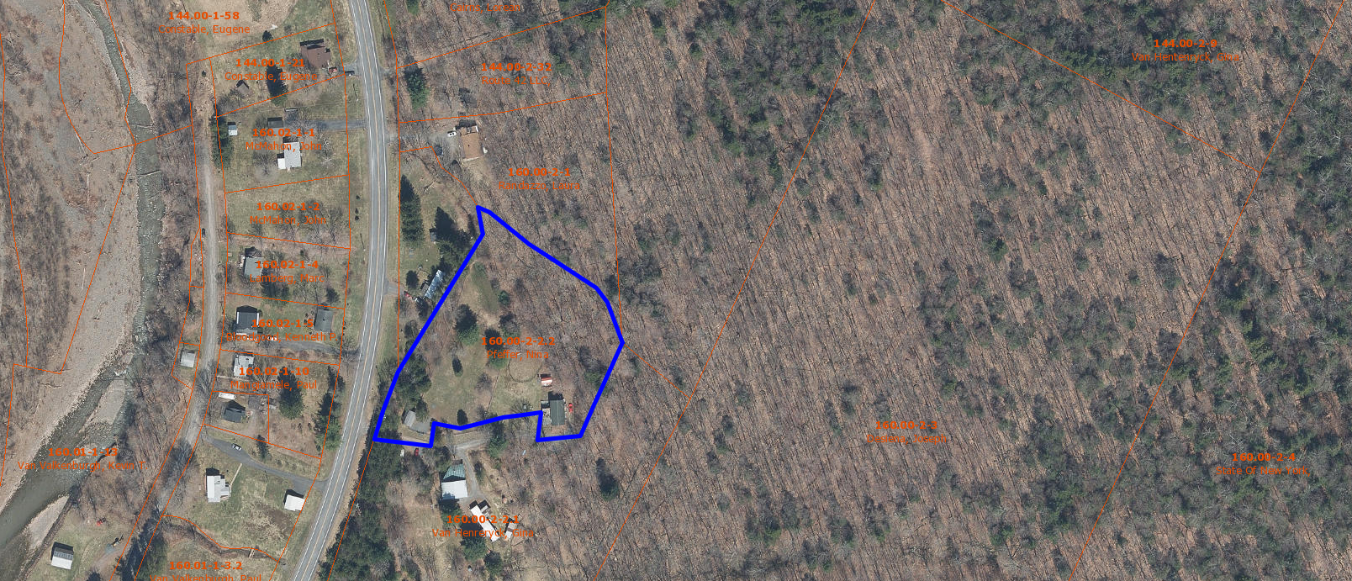
Nina Pfeffer | 2620 Rt. 42 | Westkill | 160.00-2-2.2 | 2.3

Slide 15
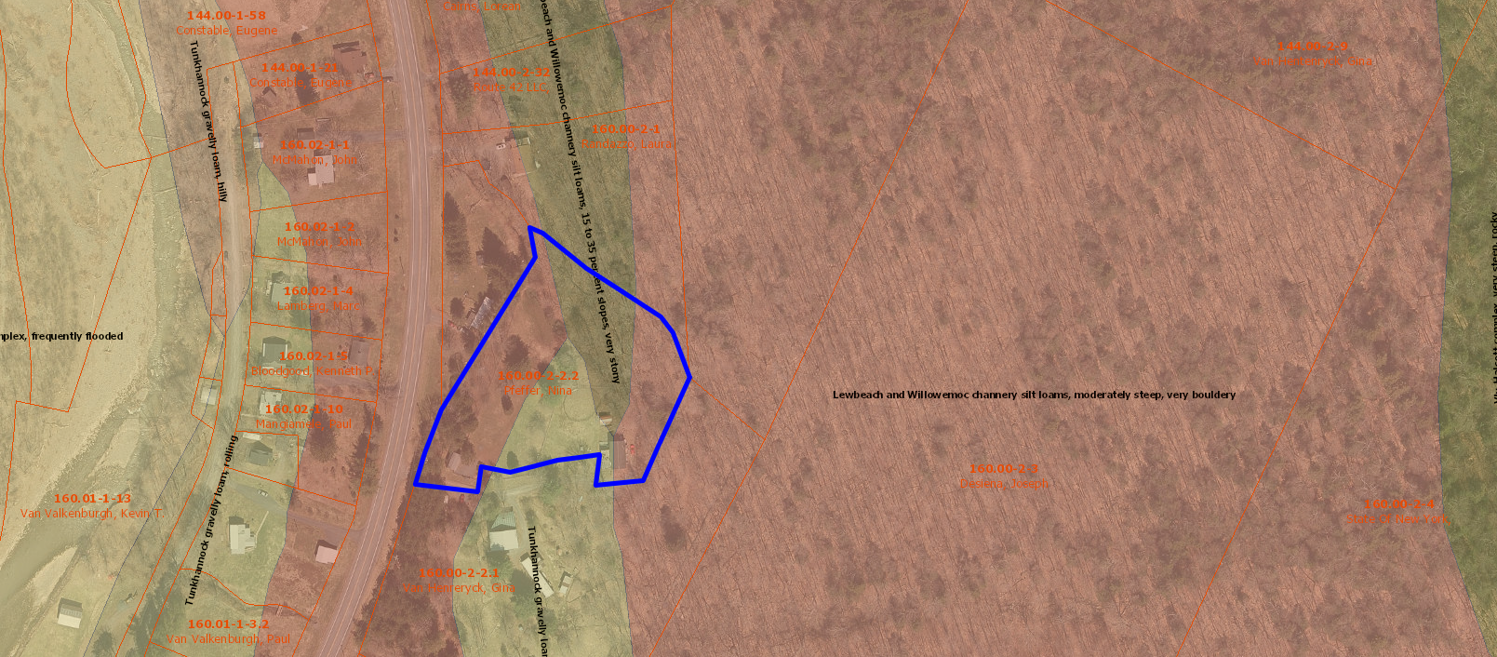
Nina Pfeffer | 2620 Rt. 42 | Westkill | 160.00-2-2.2 | 2.3

Slide 16
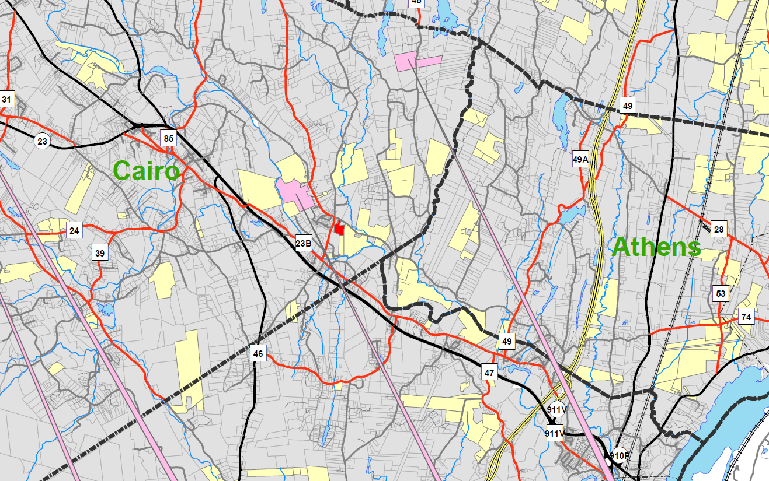
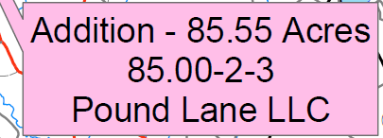
Pound Lane LLC | 1294 Rudolph Weir Jr Rd. | Earlton | 85.00-2-3 | 85.55

Slide 17
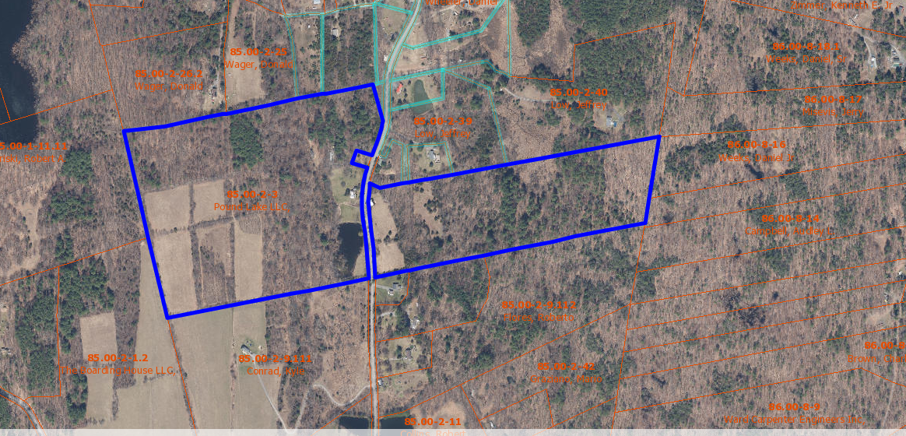
Pound Lane LLC | 1294 Rudolph Weir Jr Rd. | Earlton | 85.00-2-3 | 85.55

Slide 18
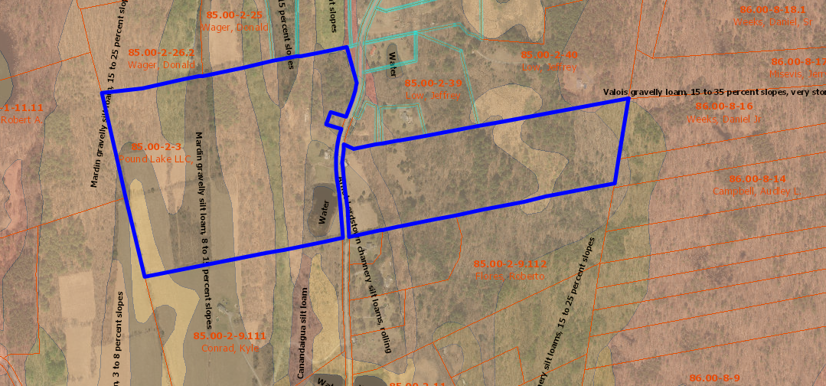
Nina Pfeffer | 2620 Rt. 42 | Westkill | 160.00-2-2.2 | 2.3

Slide 19
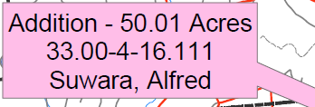
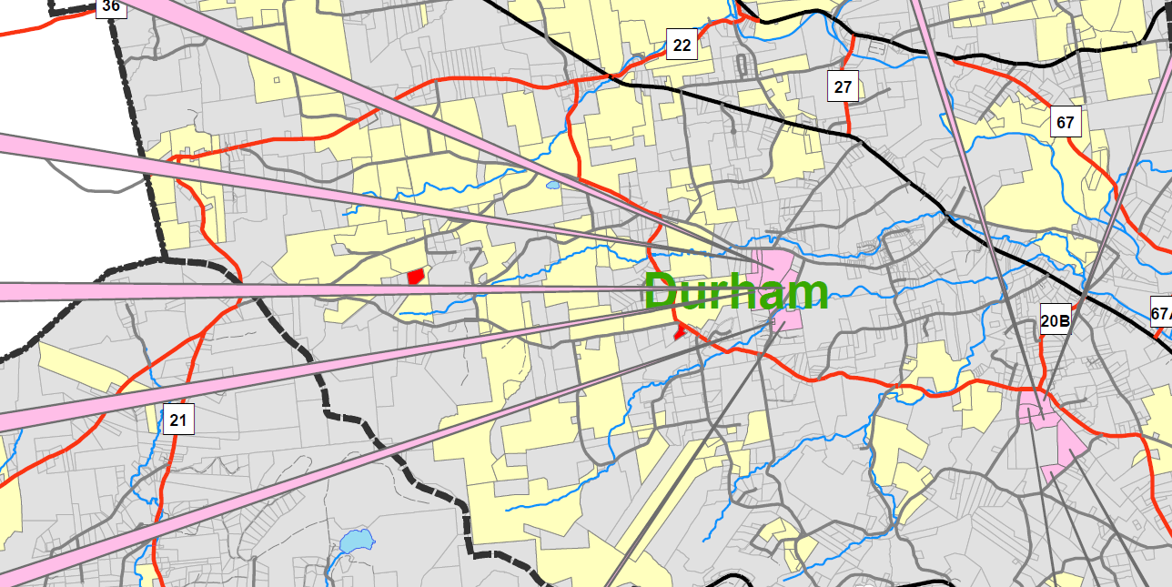
Alfred Suwara | 707 Stonebridge Rd | Cornwallville | 33.00-4-16.111 | 50

Slide 20
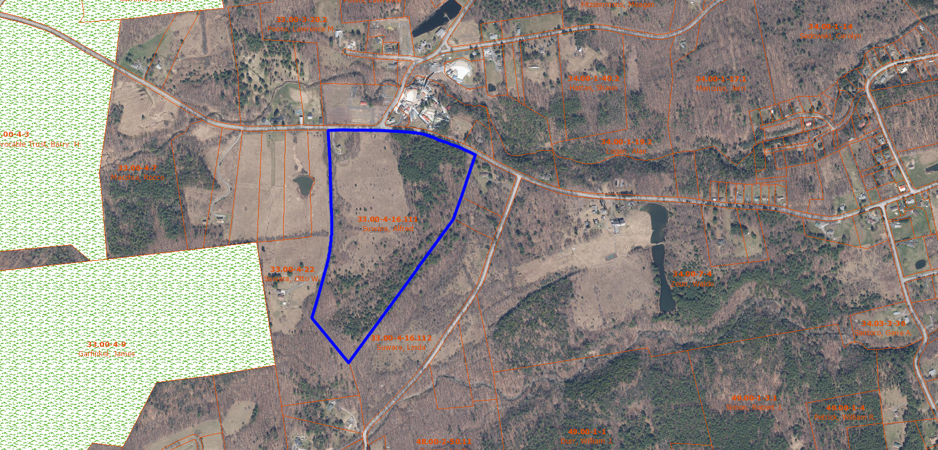
Alfred Suwara | 707 Stonebridge Rd | Cornwallville | 33.00-4-16.111 | 50

Slide 21
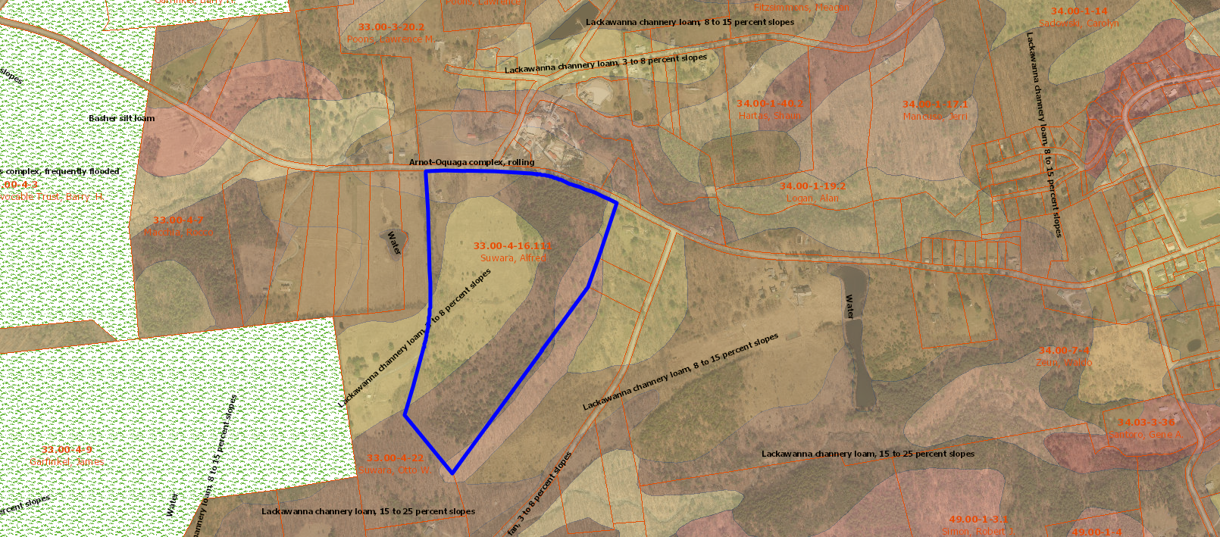
Alfred Suwara | 707 Stonebridge Rd | Cornwallville | 33.00-4-16.111 | 50

Slide 22
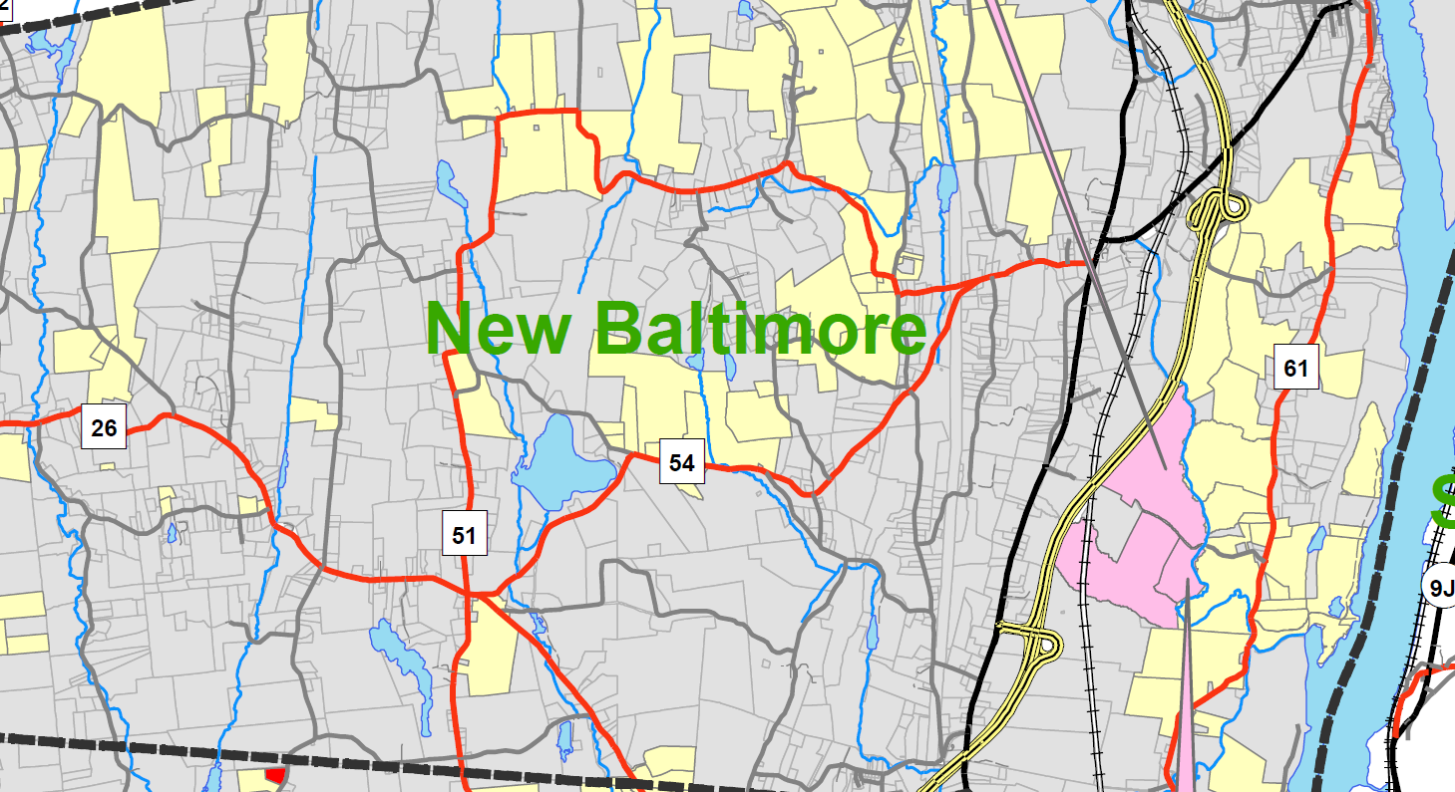
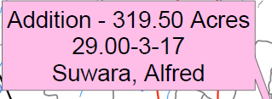
Alfred Suwara | 156 E. Hawley Ln. | Hanacroix | 29.00-3-17 | 319.5

Slide 23
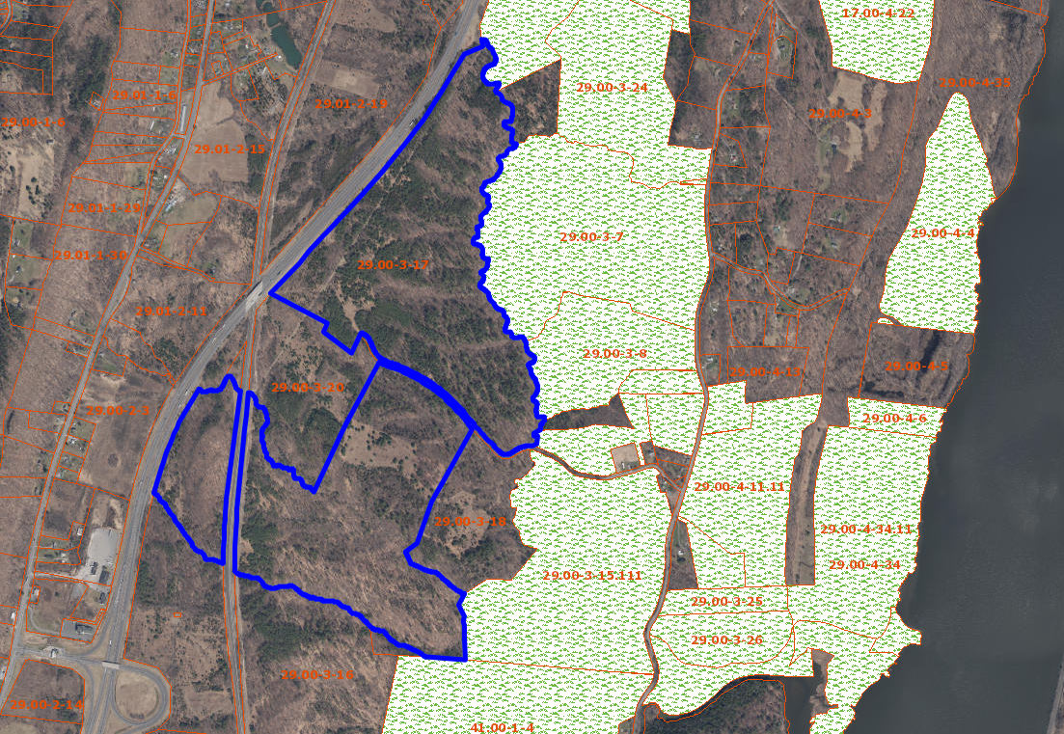
Alfred Suwara | 156 E. Hawley Ln. | Hanacroix | 29.00-3-17 | 319.5

Slide 24
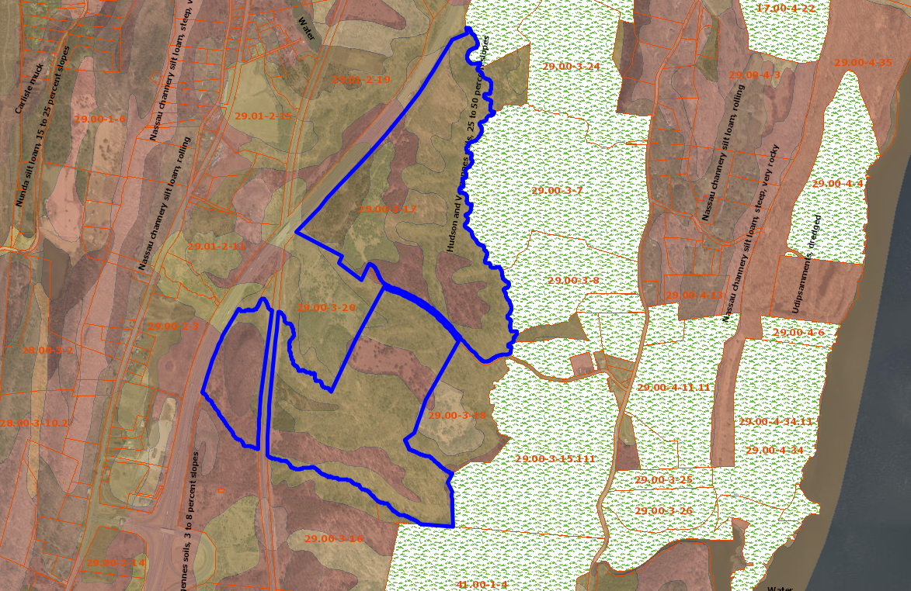
Alfred Suwara | 156 E. Hawley Ln. | Hanacroix | 29.00-3-17 | 319.5

Slide 25
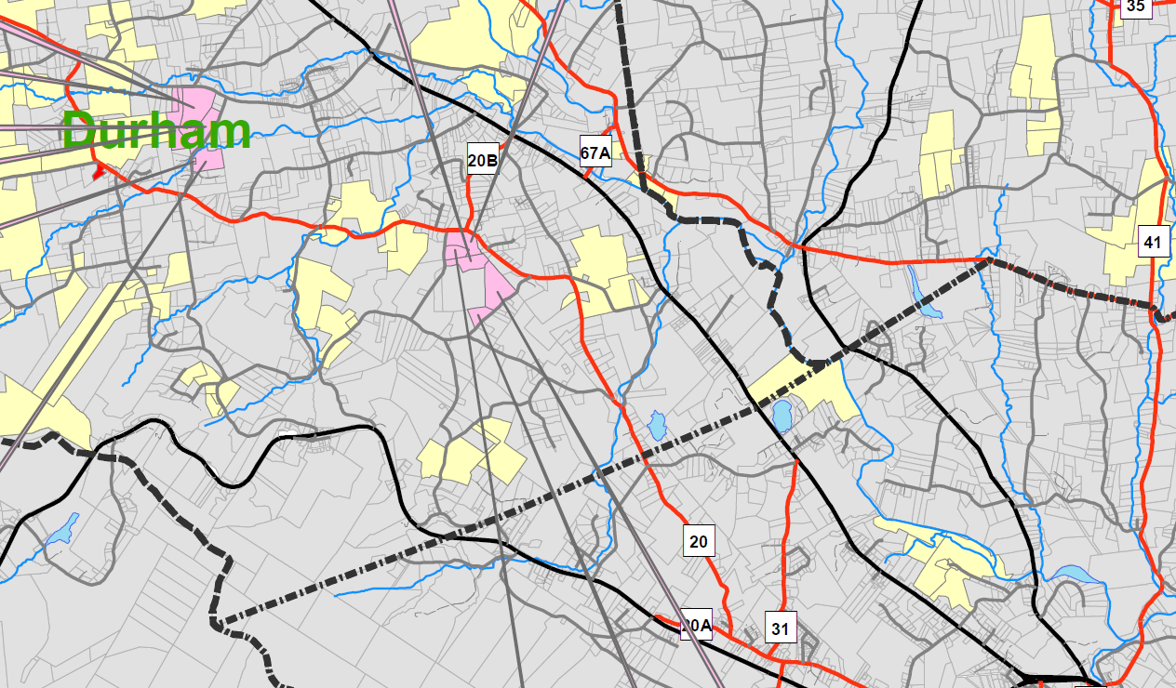
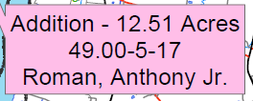
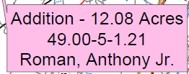
Anthony Roman | Route 20 | Durham | 49.00-5-1.22 | 22.3
Anthony Roman | 258 Dunn Rd | Durham | 49.00-5-1.21 | 12.08
Anthony Roman | 204 Dunn Rd | Durham | 49.00-5-1.1 | 19.9
Anthony Roman | 168 Paddock Rd | Durham | 49.00-5-17 | 12.51
Anthony Roman | Paddock Rd | Durham | 49.00-5-6 | 38.00

Slide 26
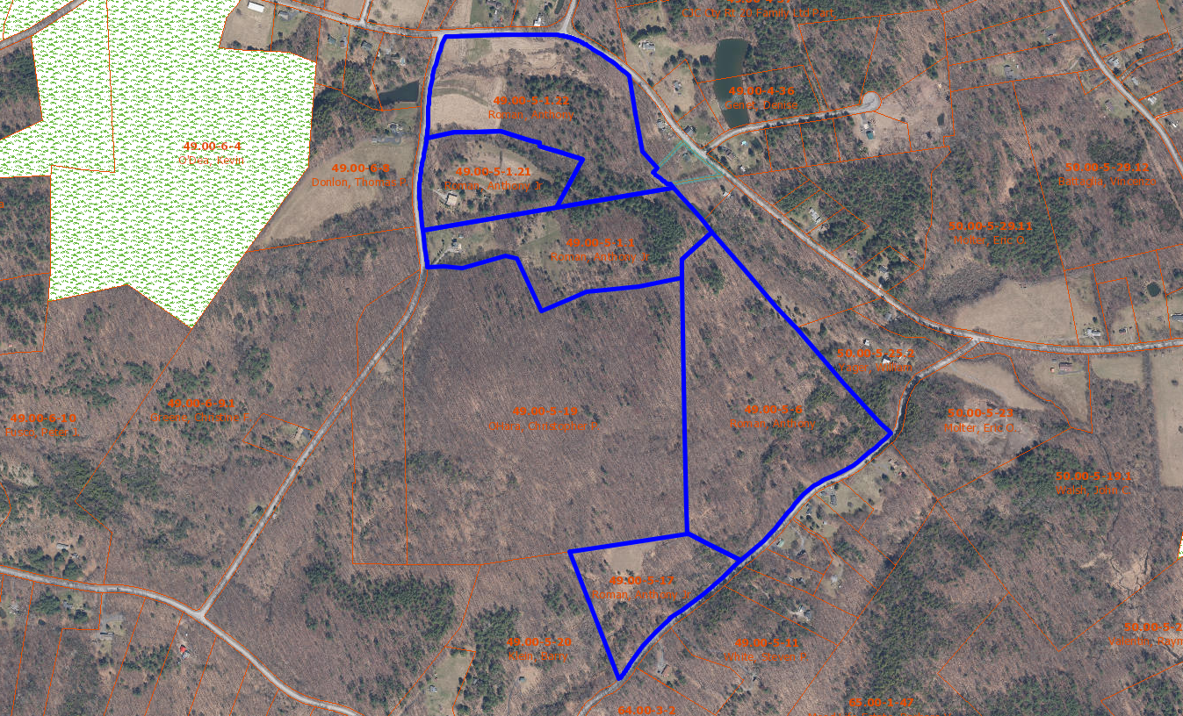
Anthony Roman | Route 20 | Durham | 49.00-5-1.22 | 22.3
Anthony Roman | 258 Dunn Rd | Durham | 49.00-5-1.21 | 12.08
Anthony Roman | 204 Dunn Rd | Durham | 49.00-5-1.1 | 19.9
Anthony Roman | 168 Paddock Rd | Durham | 49.00-5-17 | 12.51
Anthony Roman | Paddock Rd | Durham | 49.00-5-6 | 38.00

Slide 27
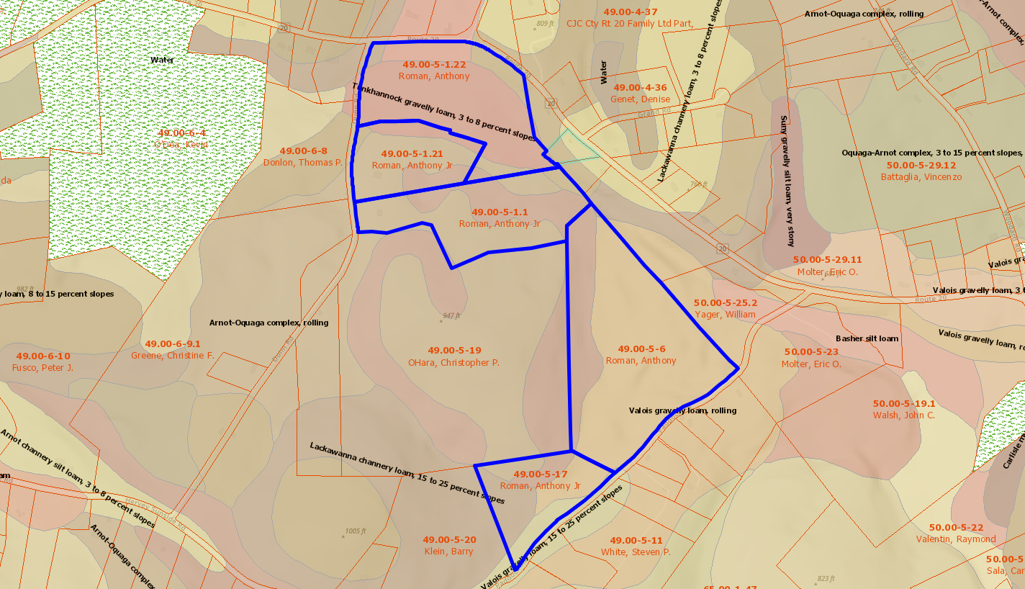
Anthony Roman | Route 20 | Durham | 49.00-5-1.22 | 22.3
Anthony Roman | 258 Dunn Rd | Durham | 49.00-5-1.21 | 12.08
Anthony Roman | 204 Dunn Rd | Durham | 49.00-5-1.1 | 19.9
Anthony Roman | 168 Paddock Rd | Durham | 49.00-5-17 | 12.51
Anthony Roman | Paddock Rd | Durham | 49.00-5-6 | 38.00

Slide 28
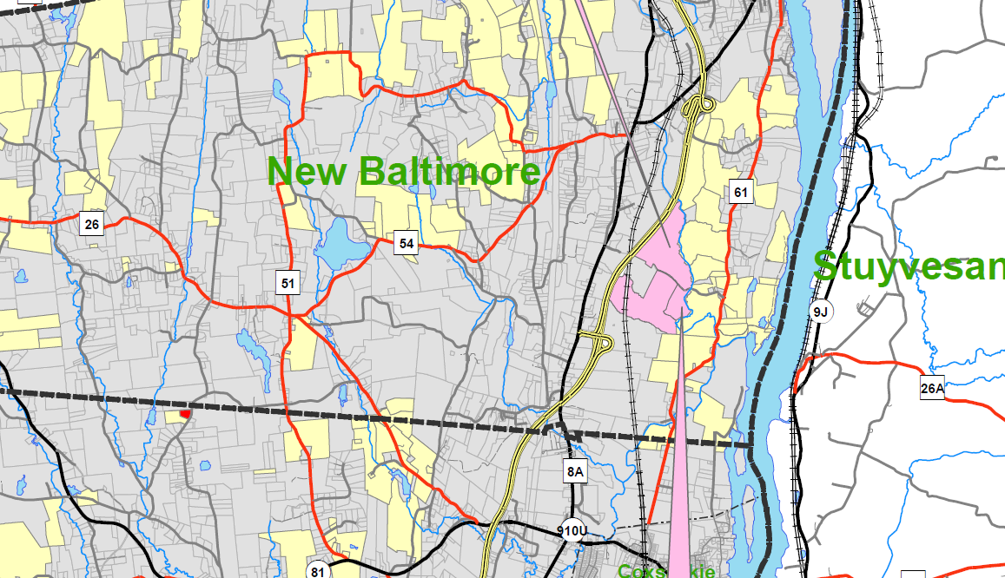
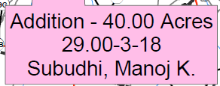
Manoj Subudhi | E Hawley Ln. | Hannacroix | 29.00-3-18 | 40.00

Slide 29
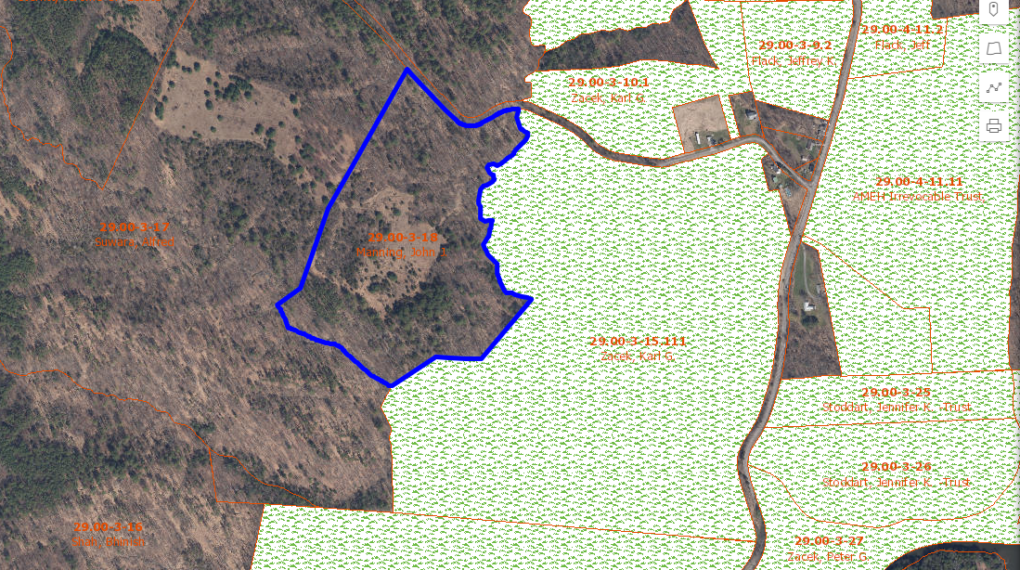
Manoj Subudhi | E Hawley Ln. | Hannacroix | 29.00-3-18 | 40.00

Slide 30
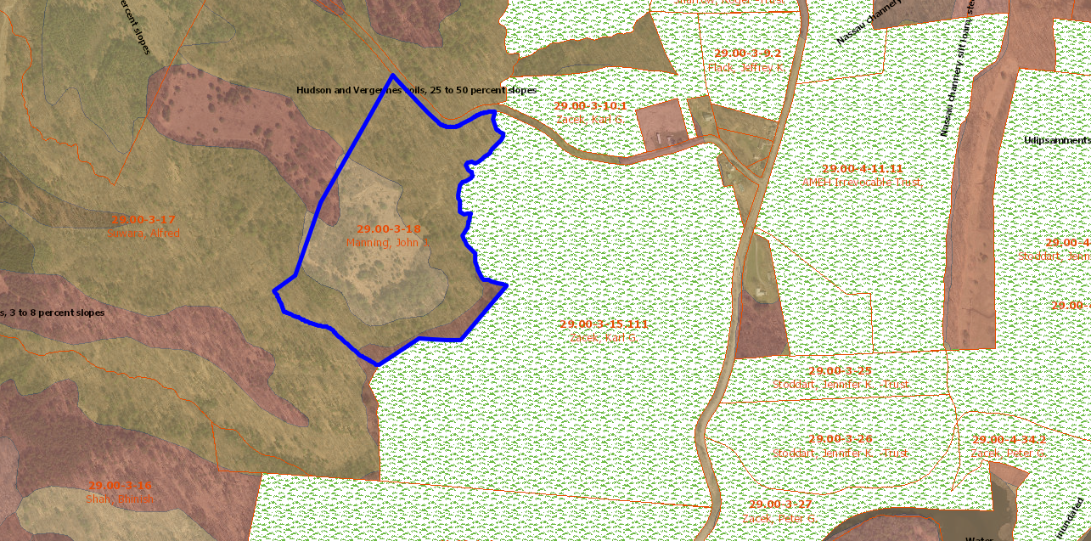
Manoj Subudhi | E Hawley Ln. | Hannacroix | 29.00-3-18 | 40.00

Slide 31
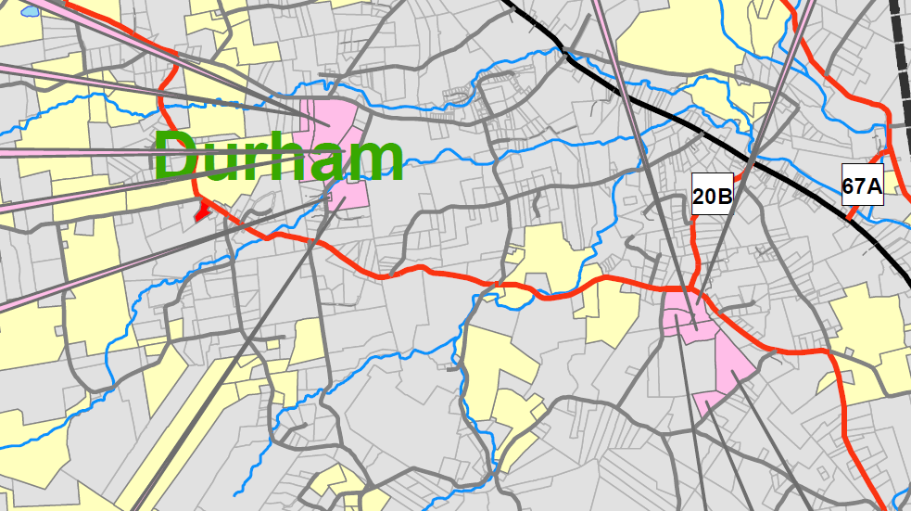
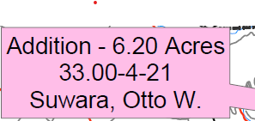
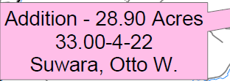
Otto Suwara | 711 Stone Bridge Rd | Cornwallville | 33.00-4-22 | 28.90
Otto Suwara | 711 Strone Bridge Rd | Cornwallville | 33.00-4-21 | 6.20

Slide 32
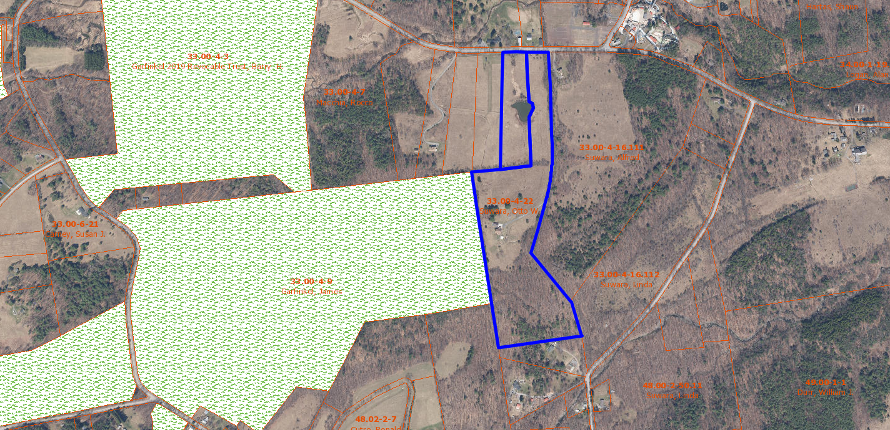
Otto Suwara | 711 Stone Bridge Rd | Cornwallville | 33.00-4-22 | 28.90
Otto Suwara | 711 Strone Bridge Rd | Cornwallville | 33.00-4-21 | 6.20

Slide 33
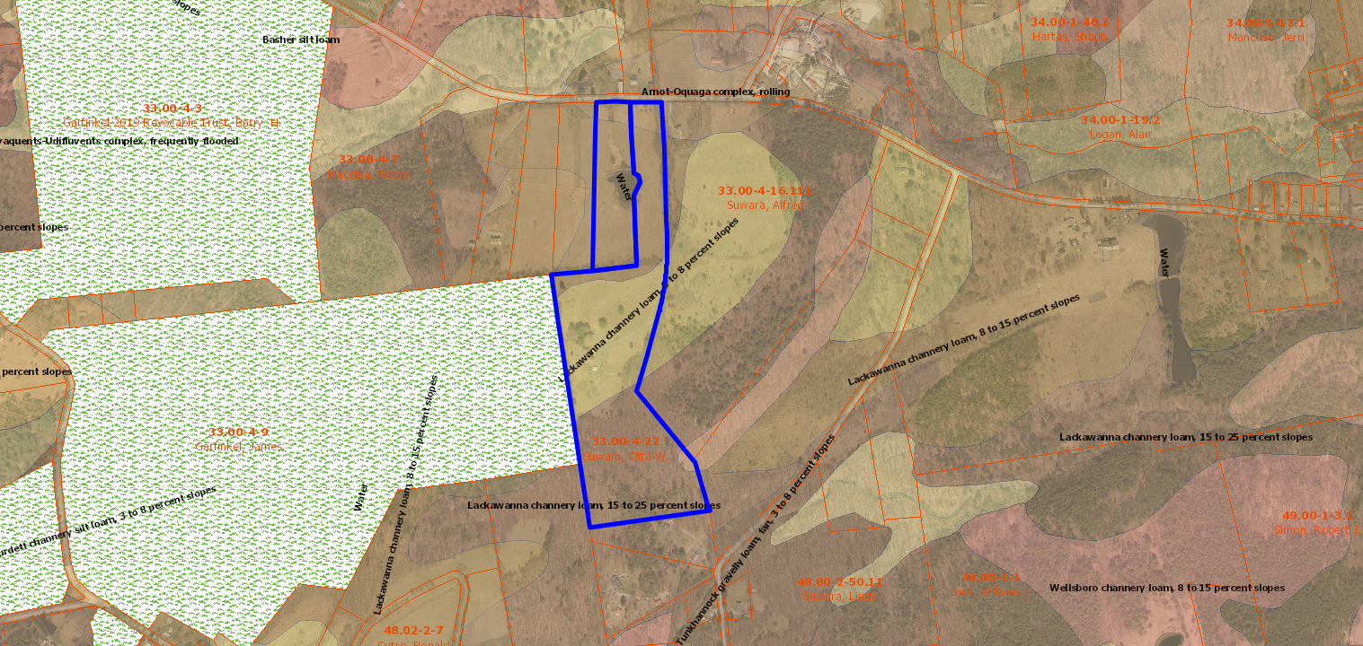
Otto Suwara | 711 Stone Bridge Rd | Cornwallville | 33.00-4-22 | 28.90
Otto Suwara | 711 Strone Bridge Rd | Cornwallville | 33.00-4-21 | 6.20

Slide 34
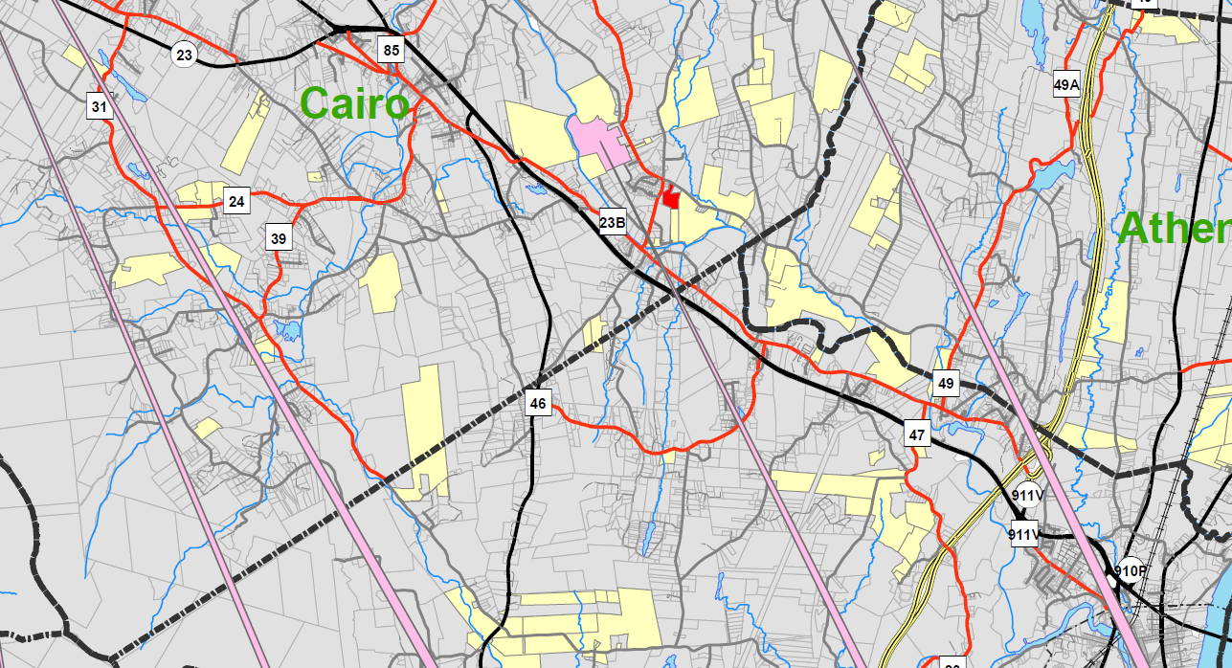
Angela Worth | 513 Rt. 67 | Leeds | 101.00-2-67 | 120

Slide 35
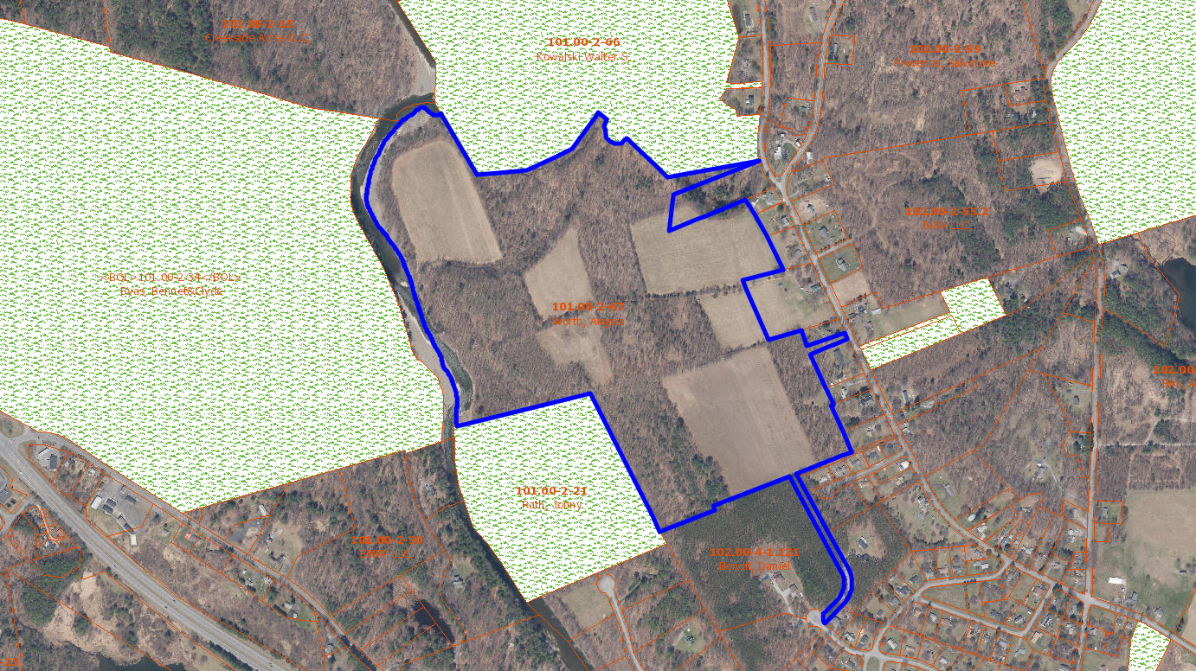
Angela Worth | 513 Rt. 67 | Leeds | 101.00-2-67 | 120

Slide 36
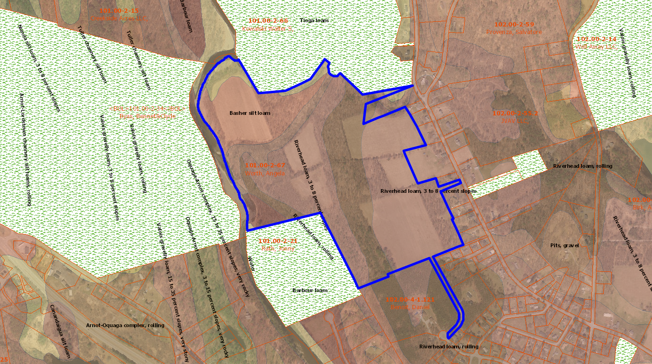
Angela Worth | 513 Rt. 67 | Leeds | 101.00-2-67 | 120

Slide 37
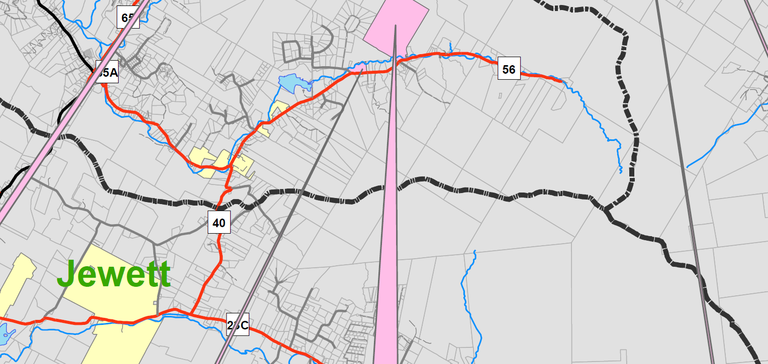
GCSWCD | 421 CR56 | Windham | 97.00-3-37 | 12.28

Slide 38
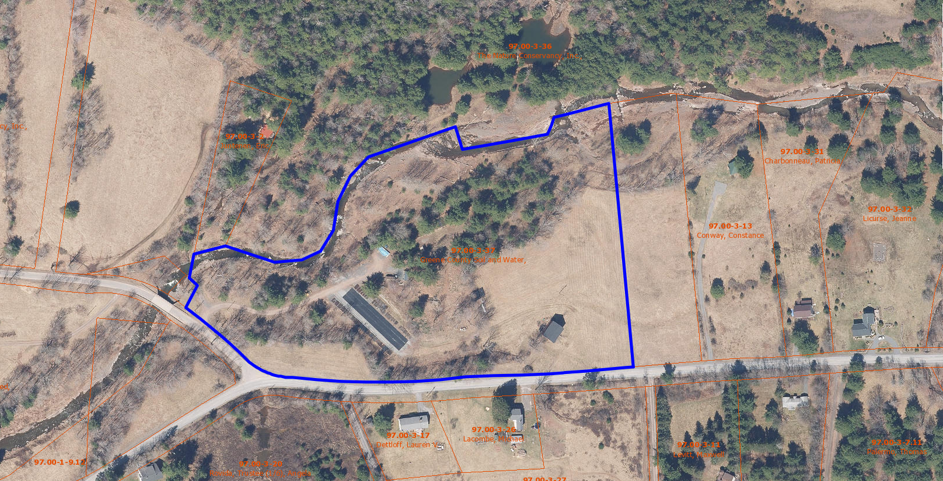
GCSWCD | 421 CR56 | Windham | 97.00-3-37 | 12.28

Slide 39
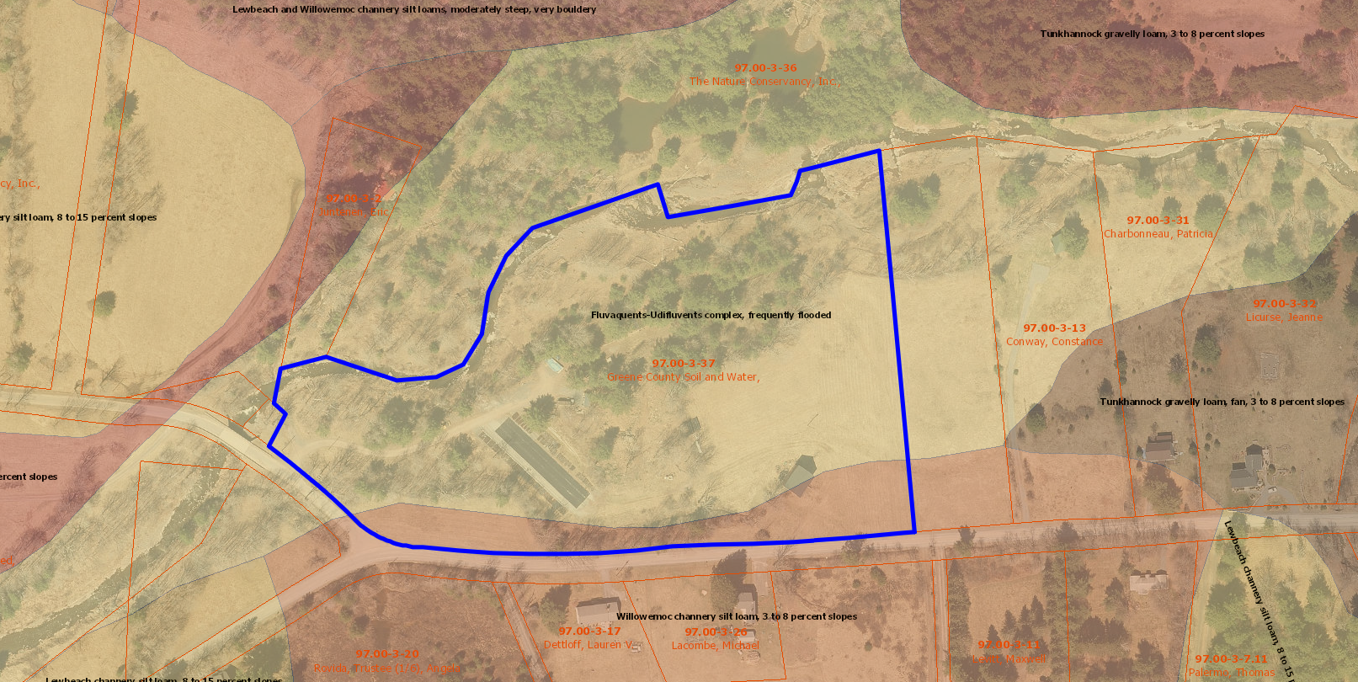
GCSWCD | 421 CR56 | Windham | 97.00-3-37 | 12.28

Slide 40
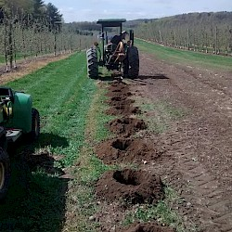
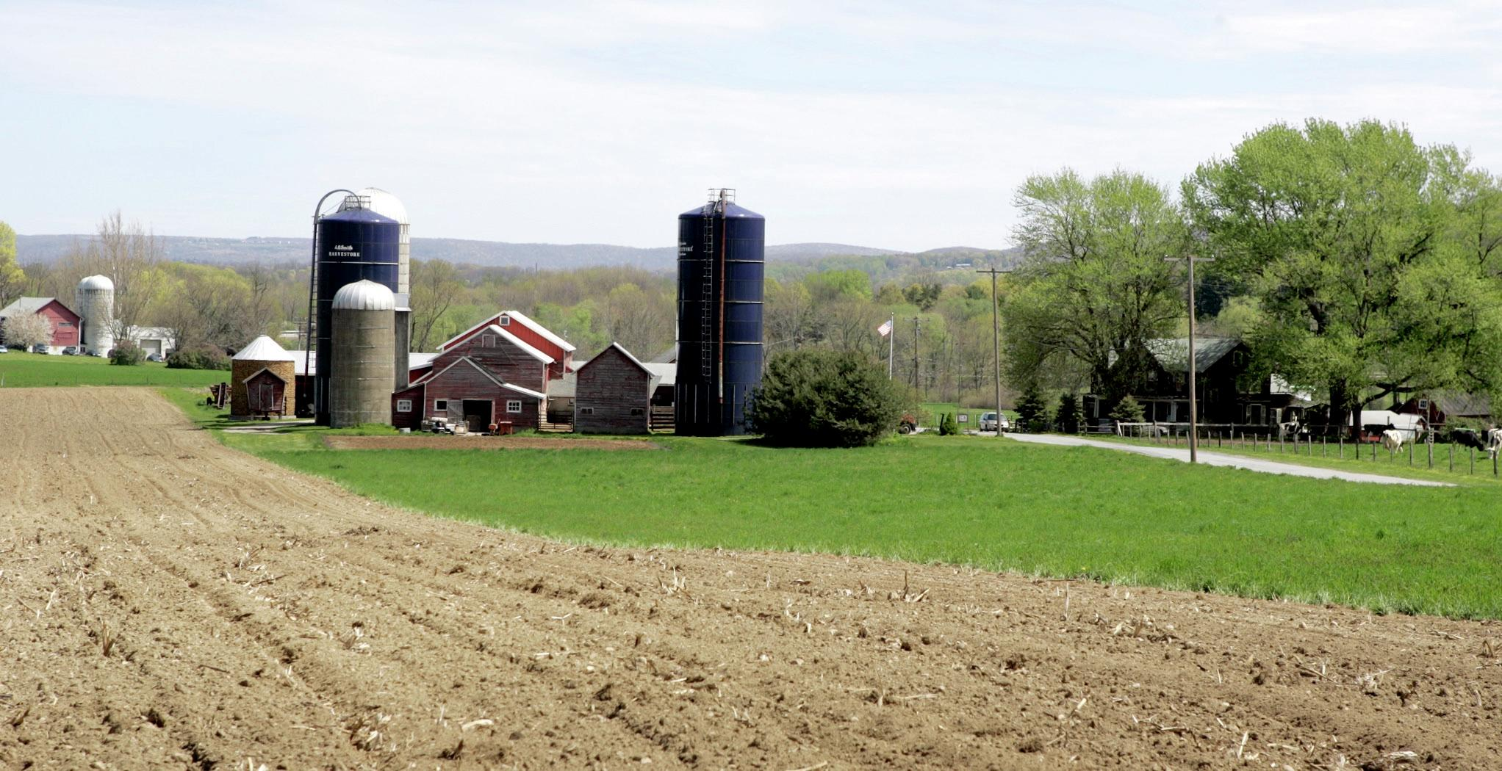
Proposed additions to Ag District
Acres
Requests for Inclusion 1,032.82
TOTAL 1,032.82
Current District:
●823 Parcels , 41,370.69 acres
With proposed additions:
●841 Parcels 42,403.51 acres
Boehm Farm

Slide 41
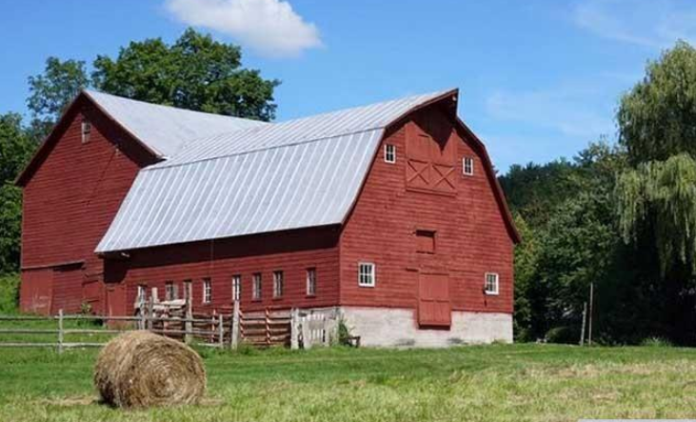
Public Hearing tentatively December 14, 2022 at 6:15PM
James Hannahs
jhannahs@discovergreene.com
(518)719-3290

