Slide 1
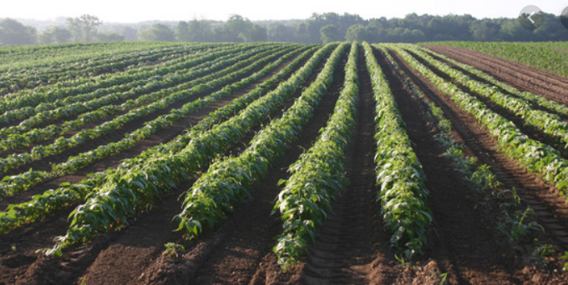
.
GREENE COUNTY AGRICULTURAL FARMLAND PROTECTION BOARD MEETING November 16, 2020 Agroforestry Center 6055 NY-23, Acra, NY 6:30 PM
CCE-CG Photo

Slide 2
Agenda
Review and discussion of 2020 Requests for Inclusion
Scheduling of Public Hearing
Nomination for replacement Henry Boehm (farmer representative)
Stoneledge Farm

Slide 3
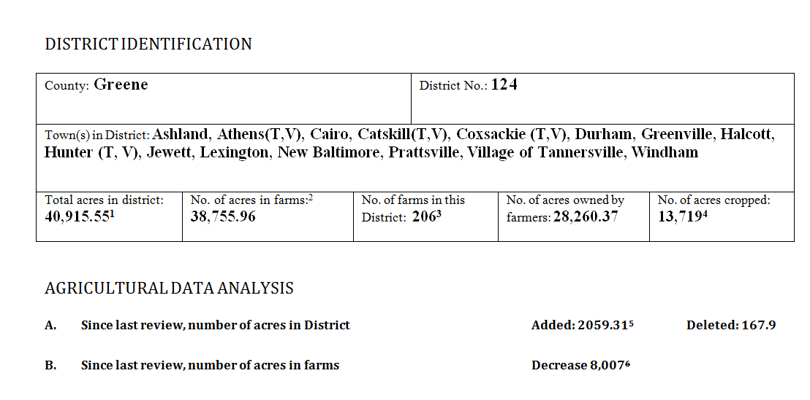
Approved Ag District No. 124 Following 2019-20 Eight-Year Review
816 Parcels
1. A. Owned and Farmed: 28,260.37 acres (69.07% of 40,915.55)
B. Rented to Farmer: 10,085.68 acres (24.65 of 40,915.55)
C. Rented From Another Landowner: 634.19 acres (1.55% of 40,915.55)
D. Not Farmed 19,353.06 acres in the Ag District No. 124 (4.73% of 40,915.55)
2.Number of acres in farms represents the sum of acres owned by farmers and rented by farmers.
3. 2017 Census of Agriculture
4. Ibid
5. Difference between 2012: 38,856.24 acres, 2020: 40,915.55 acres
6. Decrease based on acres reported on 2012 (42,986 acres) and 2017 (34,979) Census of Agriculture

Slide 4
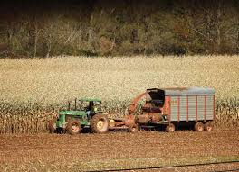
Review Processes for Agricultural District
Annual Review
Eight Year Review
(including Requests for Inclusion)
AFPBs evaluate two factors when making recommendations:
1) Whether the parcel of land consist predominantly of “viable agricultural land” and
2) Whether the inclusion of the land serve the public interest by assisting in maintaining a viable agricultural industry within the district.
Watershed Agricultural Council

Slide 5
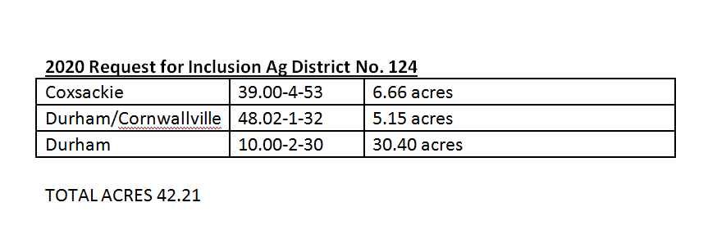
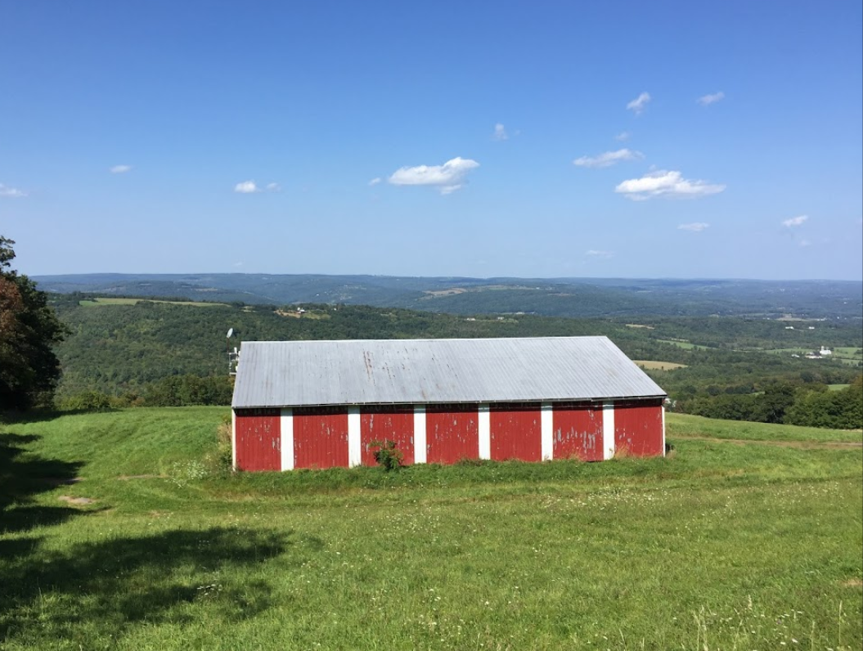
2020 Request for Inclusion Ag District No. 124
Cunningham Farm 2017
Notes:
AML Sections 303 (district creation), 303-a (district review), 303-b (annual inclusion of lands) and 303-c (district consolidation

Slide 6
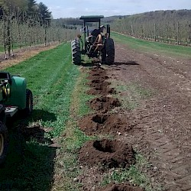
2020 Parcel Mergers Ag District No. 124
Total 27.59 acres
These parcels should have this additional acreage added in the AG124 2020 Annual Review. These were due to parcel mergers that a portion of the parcels were not in AG124 after the 2019 8 year review.
Boehm Farm
Notes:
AML Sections 303 (district creation), 303-a (district review), 303-b (annual inclusion of lands) and 303-c (district consolidation

Slide 7
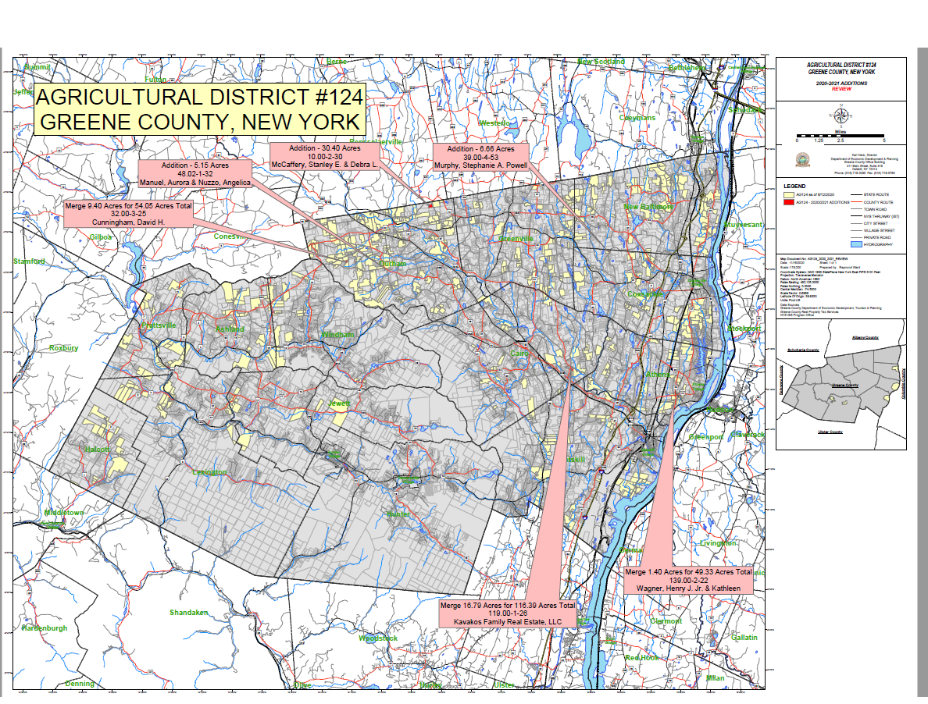

Slide 8
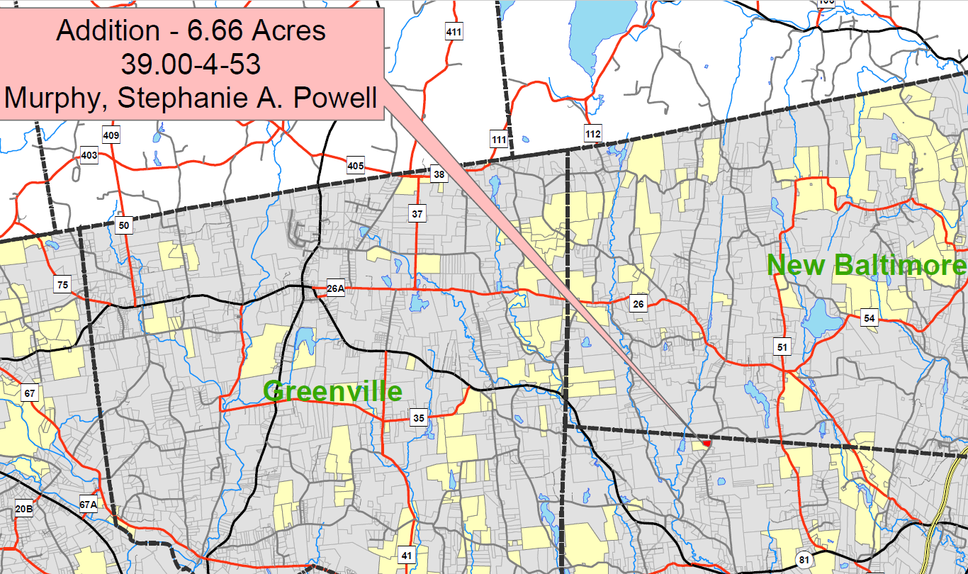

Slide 9
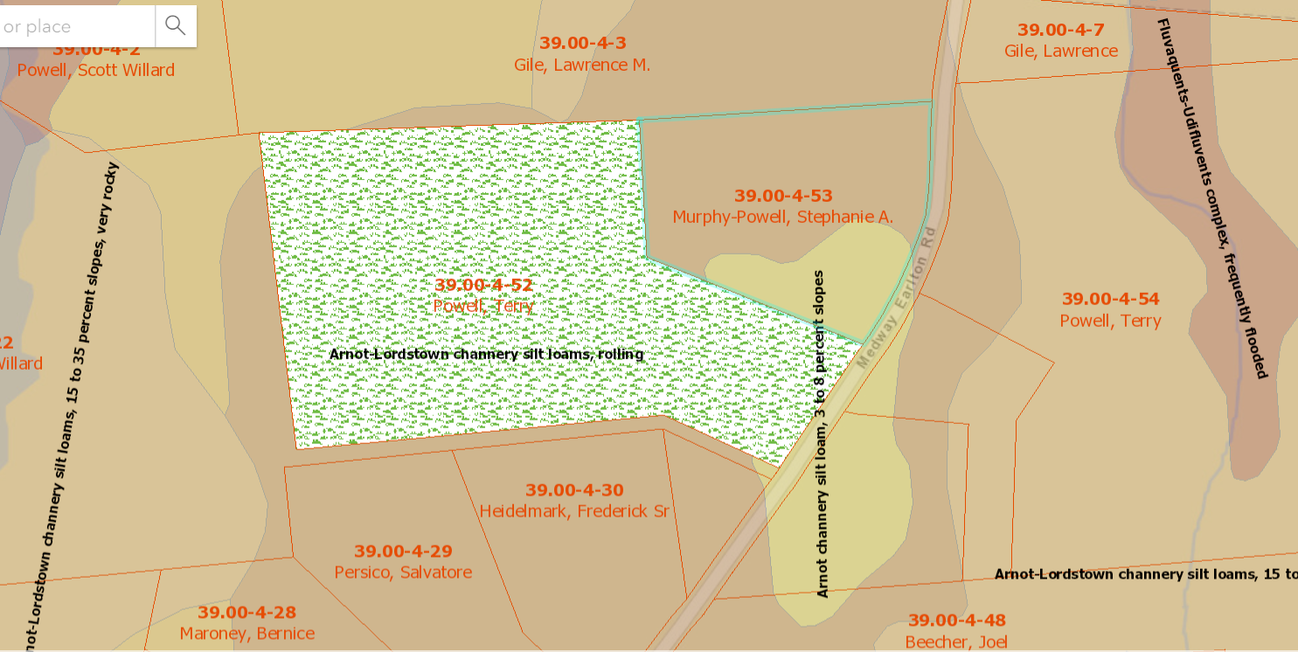
39.00-4-53
Arnot-Lordstown channery silt loam, rolling
Arnot-Lordstown channery silt loam, 3 to 8 percent slope
g

Slide 10
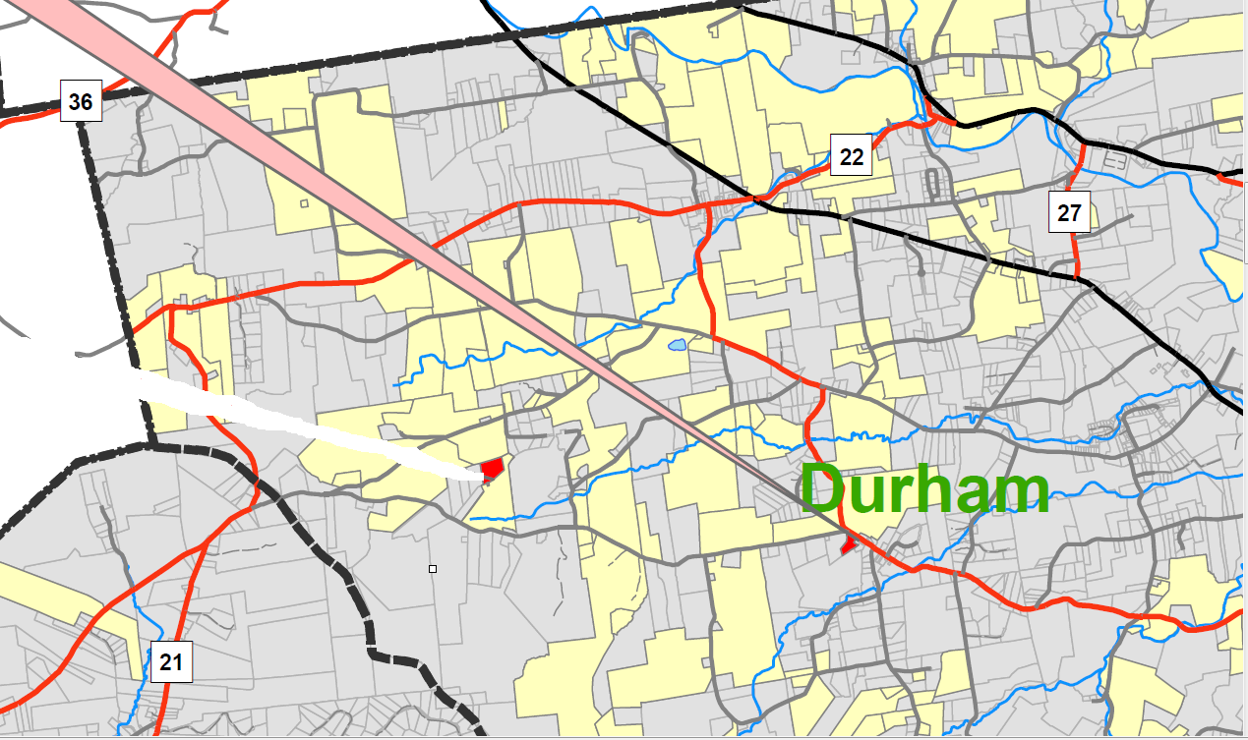

Slide 11
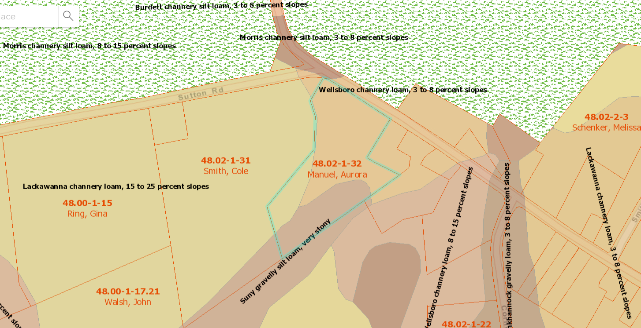
48.02-1-32
Wellsboro channery loam, 3 to 8 percent slope
Suny gravelly silt loam, very stony

Slide 12
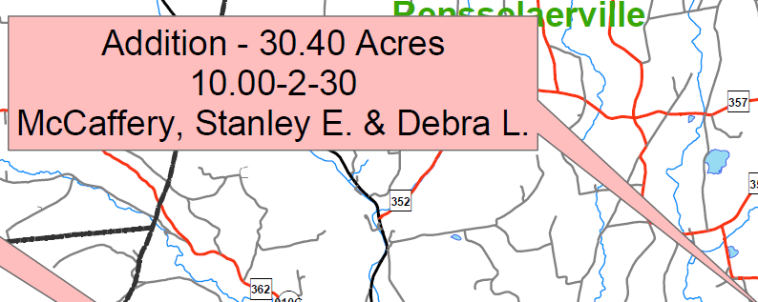
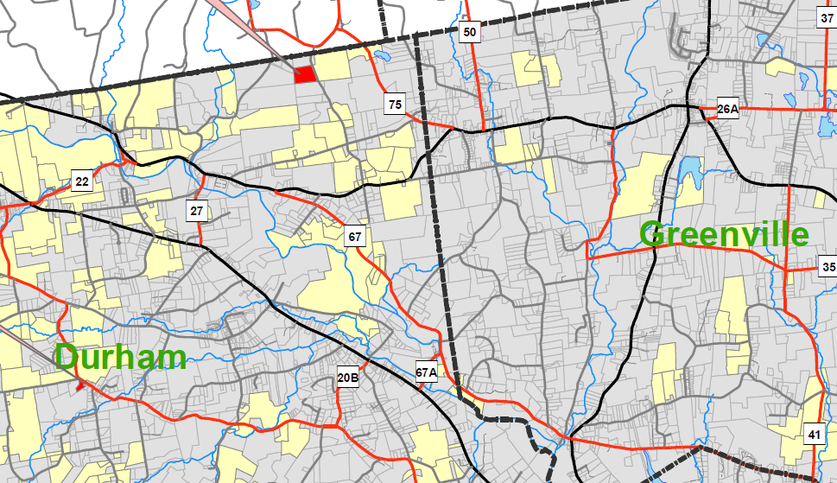

Slide 13
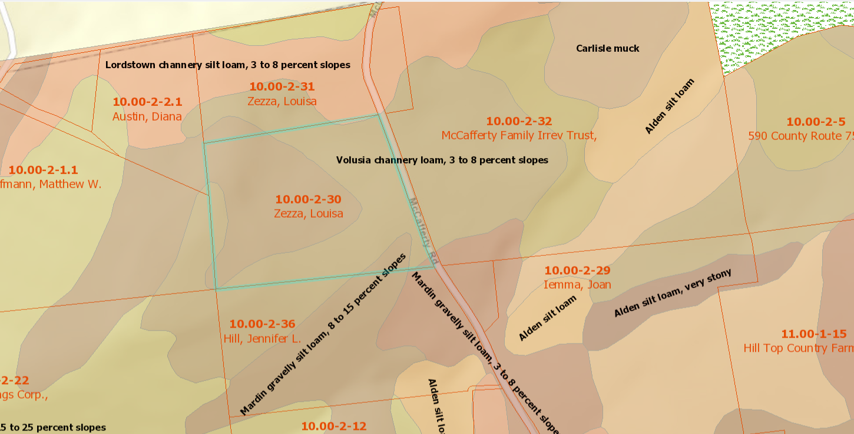
10.00-2-30 McCafferty (Zezza)
Mardin gravelly silt loam, 8 to 15 percent slope
Volusia channery loam, 3 to 8 percent slope

Slide 14
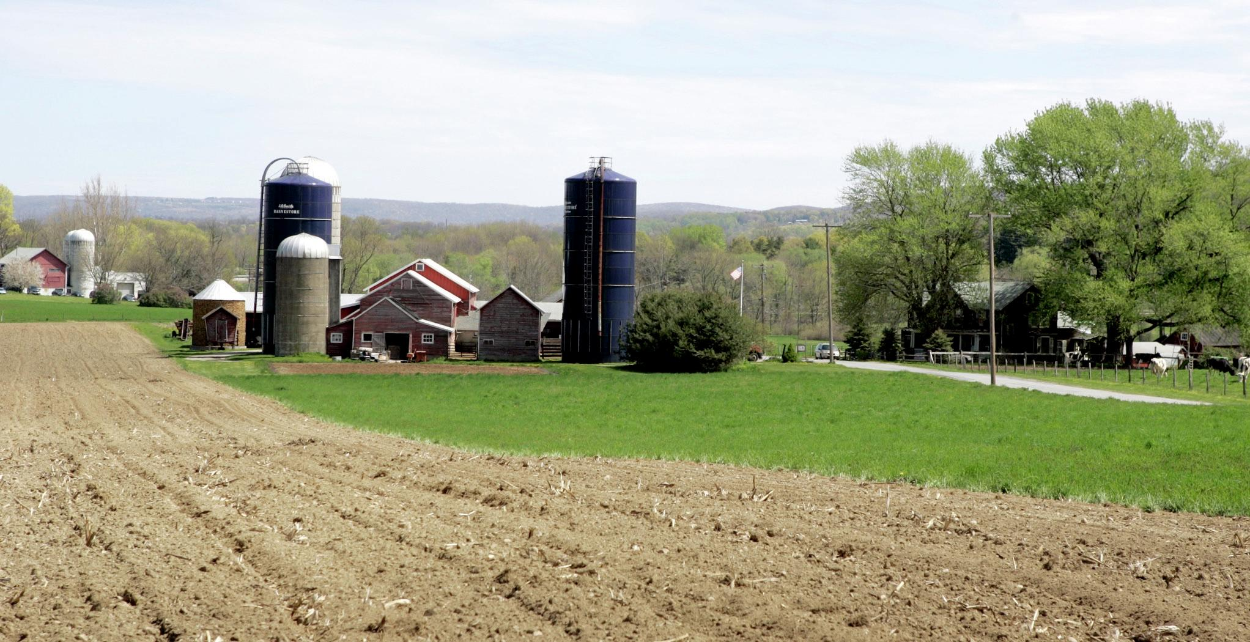
Proposed additions to Ag District
Acres
Requests for Inclusion 42.21
Parcel Mergers 27.59
TOTAL 69.80
Current District:
●816 parcel, 40,915.55
With proposed additions:
●819 Parcel 40,985.35

Slide 15
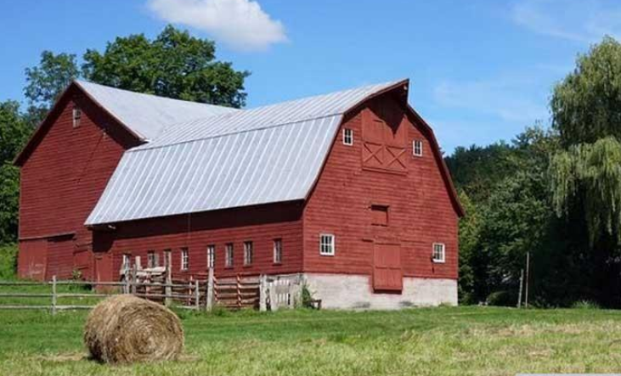
Public Hearing tentatively December 16, 2020
Rich Schiafo
rschiafo@discovergreene.com
(518)719-3290

