Slide 1

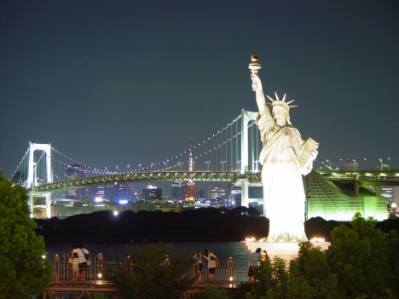



The Economic Impact of Tourism in New York
2017 Calendar Year
Catskills Focus
Notes:
1

Slide 2
State Summary

Slide 3
Key trends in 2017
New York State’s tourism economy expanded in 2017 with 4.4% growth in traveler spending, reaching a new high of $67.6 billion--27% above the state’s pre-recession peak set in 2008.
Key data illustrate the industry’s performance:
  Room demand expanded 3.8% in 2017. However, a slight decline in room rates of 0.4% led to a total hotel revenue increase of 3.4% according to STR.
  Passenger counts at all NYS airports increased 2.3% in 2017, though associated ticket revenue declined for the third consecutive year (down 3.3%).
Personal income climbed 6.0% over the prior year, outpacing the general economy.

Slide 4
Headline results
Travel & tourism is a substantial and growing component of the New York State economy.
Direct spending of $67.6 billion generated nearly $109 billion in total business sales including indirect and induced impacts.
Total income of $36.5 billion was sustained by tourism activity in 2017.
New York State tourism generated $8.5 billion in state and local taxes in 2017, saving each NYS household an average of $1,172 in taxes.

Slide 5
Tourism is vital to the NYS labor market
The unemployment rate in New York State was 4.7% in 2017. If the jobs sustained by travelers were eliminated, the unemployment rate would rise to 12.9%.

Slide 6
Traveler spending growth
Traveler spending continued to expand in 2017, growing 4.4%. Excluding purchases of gasoline, traveler spending expanded 3.2% last year.
As a result, the tourism economy reached another high in 2017, with $67.6 billion in traveler spending.
Traveler spending growth has averaged 4.5% per year since the recovery began in 2010 (compound annual growth).

Slide 7
New York State tourism markets
US domestic markets supplied 70% ($47.2 bn) of the New York State’s traveler spending base in 2017.
International markets represented 30% ($20.4 bn) of the spending base.

Slide 8
Broad-based growth
Travelers increased their spending across all sectors except transportation in 2017. Higher prices for food and fuel factored into increase in traveler spending.
Spending increased the most in retail and service stations, as gas prices rose significantly over the prior year.
Growth was also strong in the food service and recreation sectors, increasing 5.1% and 4.8%, respectively, over 2016.

Slide 9
Traveler spending distribution
Traveler spending is diverse and well-distributed across multiple sectors of the economy.
While spending shares remained similar to 2016, higher fuel prices shifted traveler spending back to transportation.

Slide 10
Historic traveler spending by sector

Slide 11
Traveler spending by market
Spending from all market segments increased, led by international travelers. Following a lackluster 2016, visitation and spending bounced back for both Canadian and overseas travelers alike. Despite strong growth from those markets, domestic spend remains the highest in terms of levels.

Slide 12
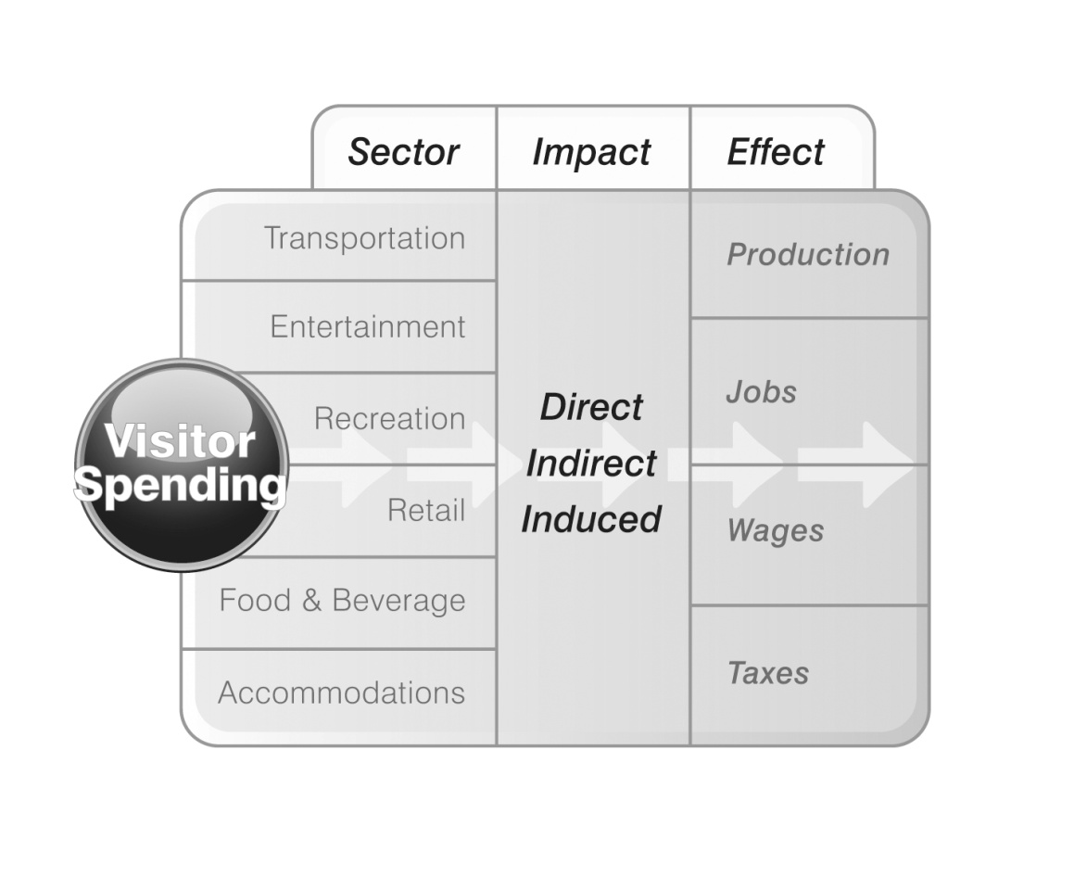
How traveler spending generates impact
Travelers create direct economic value within a discreet group of sectors (e.g. recreation, transportation). This supports a relative proportion of jobs, wages, taxes, and GDP within each sector.
Each directly affected sector also purchases goods and services as inputs (e.g. food wholesalers, utilities) into production. These impacts are called indirect impacts.
Lastly, the induced impact is generated when employees whose incomes are generated either directly or indirectly by tourism, spend those incomes in the city economy.
Notes:
12

Slide 13
Traveler-generated sales
Including the indirect and induced impacts, traveler spending generated nearly $109 billion in business sales in 2017, increasing 3.7%.

Slide 14
Traveler-generated sales
Significant indirect benefits
* Direct sales include cost of goods sold for retail
** Air transport includes local airline and airport operations, including sales generated by inbound visitors, plus outbound and transit passengers
*** FIRE = Finance, Insurance, and Real Estate

Slide 15
Traveler-generated income
Tourism-generated income grew 5.4% as a function of both employment growth and pay increases, registering $36.5 billion in 2017.

Slide 16
Traveler-generated income
FIRE = Finance, Insurance, and Real Estate

Slide 17
Tourism tax generation
Tourism generated nearly $17.9 billion in taxes in 2017, growing 4.3%.
Total state and local tax proceeds of $8.5 billion saved the state’s households an average of $1,172 in tax burden.

Slide 18
Tourism tax generation: State vs. Local
Tourism generated $3.7 billion in state taxes, and $4.8 billion in local taxes in 2017.

Slide 19
Regional Summary

Slide 20
Traveler spending by region
Traveler Spending, 2017
New York State is divided into 11 economic regions.
New York City is the largest single tourism region with 65% of state visitor spend.
New York City, Long Island and Hudson Valley together comprise nearly 80% of New York State traveler spend.

Slide 21
Upstate traveler spending by region
Upstate Traveler Spending, 2017
Traveler spending across the upstate regions of New York is more evenly distributed (excludes NYC and Long Island).

Slide 22
Reliance on tourism
Tourism Share of Regional
Employment in 2017
Tourism is an integral part of every region’s economy, generating from 6% to 19% of employment.
Tourism is most important to the Adirondacks and Catskills, generating 19% and 16% of total employment, respectively.
Note: All regional and county tourism shares are calculated using QCEW (ES-202) employment and wage totals as produced by the NYS Dept. of Labor.

Slide 23
Traveler spending growth
Traveler spending increased in all regions in 2017, generally at a lower rate than in 2016.
The strongest growth occurred in the Catskills, Central New York, Adirondacks, and Greater Niagara regions.
Growth in traveler spending was led by recreation and food & beverage spending. Additionally, higher fuel prices contributed to an increase in service spending.
Growth in Traveler Spending

Slide 24
Regional growth
Traveler Spend
Year-Over-Year Comparison
Business
Day

Slide 25
Regional tourism summary (2017)
Tourism Economic Impact
Combined Direct, Indirect, and Induced
Business
Day

Slide 26
Regional tourism impact distribution (2017)
Tourism Economic Impact
Regional Shares
Business
Day

Slide 27
Regional Detail for
Catskills
Business
Day

Slide 28
Catskills, county distribution
Traveler Spending, 2016
Tourism in the Catskills is a $1.3 billion industry, supporting 18,542 jobs.
Ulster County represents 45% of the region’s tourism sales with $587 million in traveler spending.
Traveler spending in the region grew by 7.1% in 2017.
Business
Day

Slide 29
Catskills, total tourism impact

Slide 30
Catskills, traveler spending
Traveler Spending, 2017
Travelers spent $1.3 billion in the Catskills region in 2017 across a diverse range of sectors.
Spending on lodging and expenses related to second homes comprised 37% and 24% of the total, respectively.
Business
Day

Slide 31
Catskills, traveler spending

Slide 32
Regional growth

Slide 33
Catskills, labor income
Tourism-Generated Labor Income
Business
Day
Tourism in the Catskills region generated $367 million in direct labor income and $607 million including indirect and induced impacts.
Tourism is most significant in Ulster County, generating $304 million in labor income, including indirect and induced impacts.

Slide 34
Catskills, labor income
Tourism-Generated Labor Income
Share of Economy, 2017
12.5% of all labor income in the Catskills region is generated by tourism.
Sullivan County is the most dependent upon tourism with 17.2% of all labor income generated by visitors.

Slide 35
Catskills, labor income

Slide 36
Catskills, tourism employment
Tourism-Generated Employment
Share of Economy, 2017
15.9% of all employment in the Catskills region is generated by tourism.
Greene County is the most dependent upon tourism with 22.0% of all employment sustained by visitors.
Business
Day

Slide 37
Catskills, tourism employment
Tourism-Generated Employment, 2017

Slide 38
Catskills, tourism taxes
Tourism-Generated Taxes, 2017
Tourism in the Catskills region generated $159 million in state and local taxes in 2017.
Sales, property, and hotel bed taxes contributed $86 million in local taxes.
Ulster County produced 45% of the region’s tourism tax base in 2017.
Business
Day

Slide 39
Catskills, tourism taxes
Were it not for tourism-generated state and local taxes, the average household in the region would have to pay an additional $1,192 to maintain the same level of government revenue.

Slide 40
Methods and data sources
Household travel surveys from Longwoods International have provided key inputs in establishing traveler spending figures. This is a representative survey with a sample of more than 300,000 trips per year.
Industry data on lodging, airport activity, Amtrak, and attractions inform year-over-year growth analysis.
Employment definitions. The basis of our data and modeling is the Regional Economic Information System (REIS), Bureau of Economic Analysis, U.S. Department of Commerce. This is different than the NYS Department of Labor data source (ES202/QCEW). The main definitional difference is that sole-proprietors, which do not require unemployment insurance and are not counted in the ES202 data. For total employment (across all sectors), the difference is 20%.
International methodology. Our approach is based the estimates on direct survey responses to the Department of Commerce in-flight survey and Statistics Canada data - constrained to BEA international balance of payments data.
All employment and income results are constrained to known industry measurements for key tourism sectors.
Notes:
40

Slide 41
Methods and data sources
Local taxes are a build-up of individual categories (sales, occupancy, property). The model is not equipped to deal with individual exemptions such as Indian gaming.
Second home expenditures are based on the stock of seasonal second home inventory. Annual average expenditures for housing are pro-rated to the season length to account for various levels of expenditures not accounted in visitor surveys.
Lodging sector. Our models use survey information and constrains this to the value of the hotel sector in each county. This can vary from certain bed tax estimates of total revenue for several reasons. One is that the bed tax may only be based on room revenue while total sales for the industry may include other revenue sources (room service, phone, etc.). Another is that certain smaller establishments may not fully report or be required to report their revenue.
Notes:
41

Slide 42
Methods and data sources
Tourism Economics utilized the IMPLAN input-output model for New York State to track the flow of sales through the economy to the generation of GDP, employment, wages, and taxes.
The impacts are measured on three levels:
  Direct impact: The immediate benefit to persons and companies directly providing goods or services to travelers.
  Indirect impact: The secondary benefit to suppliers of goods and services to the directly-involved companies. For example, a food wholesaler providing goods to a restaurant. The model is careful to exclude imports from the impact calculations.
  Induced impact: The tertiary benefit to the local economy as incomes in the prior two levels of impact are spent on goods and services. For example, a restaurant employee spends his wages at a grocery store, generating addition economic output.
Notes:
42

Slide 43
About Tourism Economics
Tourism Economics, headquartered in Philadelphia, is an Oxford Economics company dedicated to providing high value, robust, and relevant analyses of the tourism sector that reflects the dynamics of local and global economies. By combining quantitative methods with industry knowledge, Tourism Economics designs custom market strategies, project feasibility analysis, tourism forecasting models, tourism policy analysis, and economic impact studies.
Our staff have worked with over 100 destinations to quantify the economic value of tourism, forecast demand, guide strategy, or evaluate tourism policies.
Oxford Economics is one of the world’s leading providers of economic analysis, forecasts and consulting advice. Founded in 1981 as a joint venture with Oxford University’s business college, Oxford Economics is founded on a reputation for high quality, quantitative analysis and evidence-based advice. For this, it draws on its own staff of 40 highly-experienced professional economists; a dedicated data analysis team; global modeling tools; close links with Oxford University, and a range of partner institutions in Europe, the US and in the United Nations Project Link.
For more information: info@tourismeconomics.com.

Slide 44

For more information:
+1.610.995.9600, info@tourismeconomics.com
Notes:
44

